Slide 1




PITCH
DECK

Slide 2
A powerful construction marketplace from the comfort of your couch

Slide 3
Meet the STAKEHOLDERS
THE
BUYER
Homeowners’ Companies
Providing an Optimized & Faster Procurement Experience
THE
VENDOR
Building Materials
THE
CONTRACTOR

Slide 4
THE PROBLEMS
PROBLEM 1
PROBLEM 2
Buyers/Contractors want to pay later
Vendors need cash upfront
Multiple suppliers to manage
No easy access for everyone
No fast estimation Unfair prices
Long time to get bank facility
Long time to receive proposal

Slide 5

CONSTRUCTION MARKETPLACE
WITH SOULTION
PAY LATER
Financing third party for pay later
THE
BUYER
Homeowners’ Companies
THE
VENDOR
AI-enabled :
Estimation
Offers evaluation
RFQ creation
THE
CONTRACTOR

Slide 6

BENEFITS
THE
VENDOR
THE
BUYER
THE
CONTRACTOR
30%
More Sales
Advanced Payment
INSTANT
Estimation
Vetted Vendor
Less Cost
Faster Time
Access to the Market
15%
Less Cost
Pay Later
More Sales
2-hour Procurement Cycle

Slide 7
CONSTRUCTION MARKET SIZE
CAGR 5.3%
86.70 B $
TAM
86 B $
66.75 B $
SAM
60 B $
SOM
18 B $
2022
2028
Saudi Arabia Construction Market Size
All numbers are in USD Billion

Slide 8

TRACTION
User grow
2024
New user
RFQ NB
29
300
280
200
$9
100
MILLION
0
MAR
APR
MAY
JUN
JUL
AUG
SEP
OCT
9.8K page visitors over 60 days

Slide 9






Pay Later Line of Credit
Key Clients:
$40
MILLION
from a major bank in Saudi Arabia
Major Brands:

Slide 10

AVERAGE TRANSACTION VALUE
120K USD
Estimated
Units
Villas
Small Businesses Renovation

Slide 11
MILESTONES & REVENUE PROJECTION
5000 customers B2B
160 M GMV – 1500 transaction
8 M USD revenue
30,000 customers B2B&B2C
9.6 B GMV - 90,000 transaction
480 M USD revenue
2024
2025
2026
2027
500 customers B2B
4 M GMV - 375 transaction
200 k USD revenue
10000 B2B&B2C
3.2 B GMV --30,000 transaction
160 M USD revenue

Slide 12
BUSINESS MODEL MONETIZATION
TRANSACTION COMMISSION
SUBSCRIPTION
AFFILIATION
VENDOR
-
BUYER
-
-
CONTRACTOR
-
THIRD PARTIES
-
-
LOGISTICS & PAY LATER

Slide 13




COMPETITORS ANALYSIS
PAY LATER
-
-
-
OFFERS WITHIN 2 HR
-
-
-
ANONYMOUS PRICING
-
-
-
-
PRICE ESTIMATION
-
-
-
-
RFP PROCESSING
-
-
-
RFQ PROCESSING
-
LOGISTICS
-
LOGISTICS & PAY LATER
-
-
-
-
AI TECHNOLOGY

Slide 14

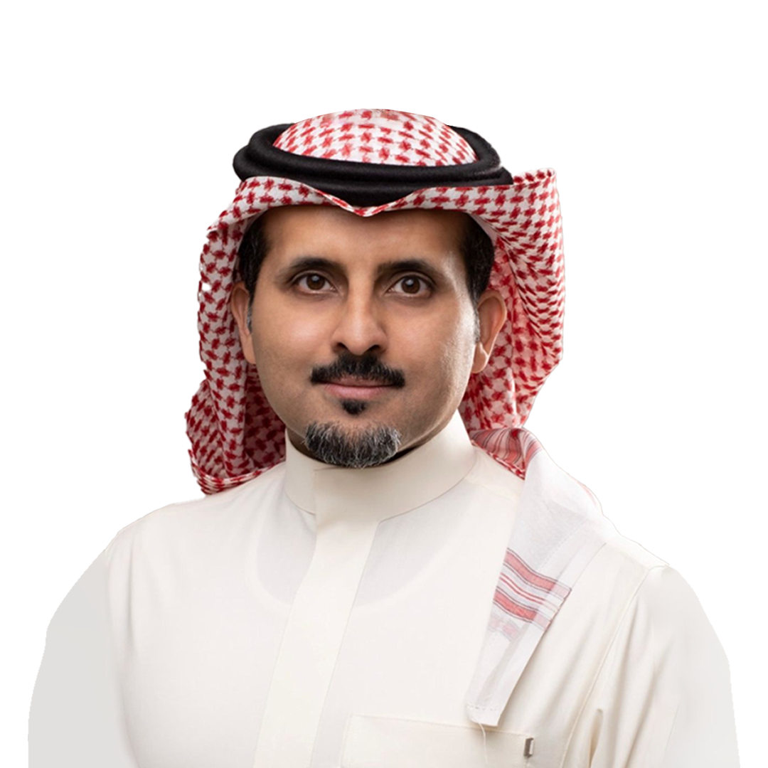
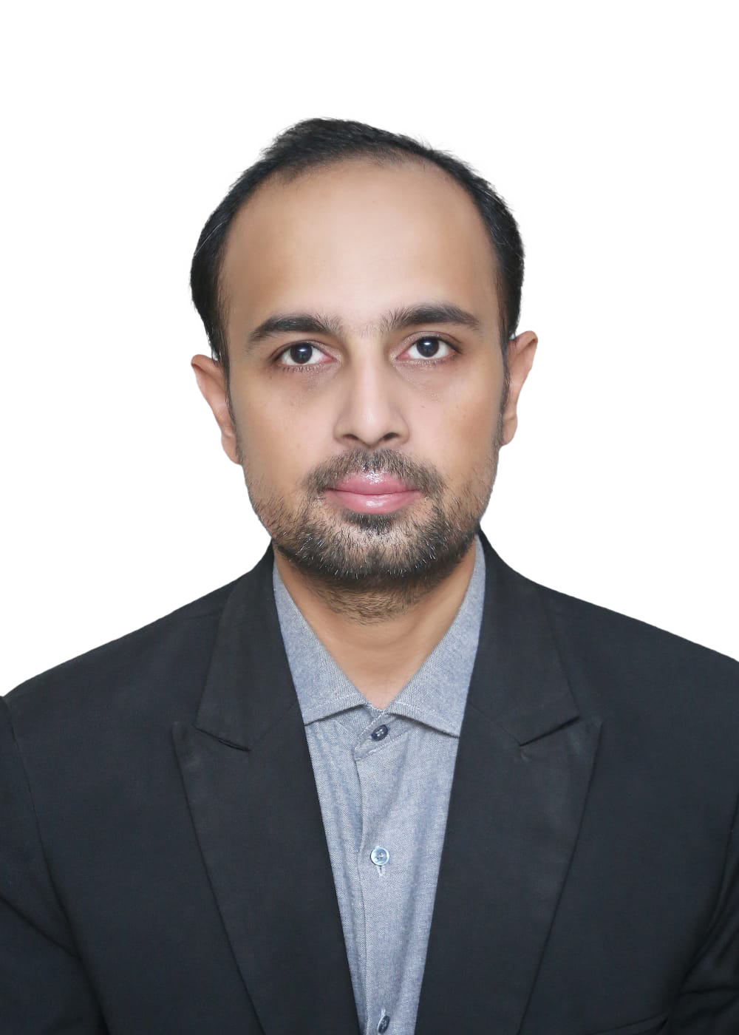

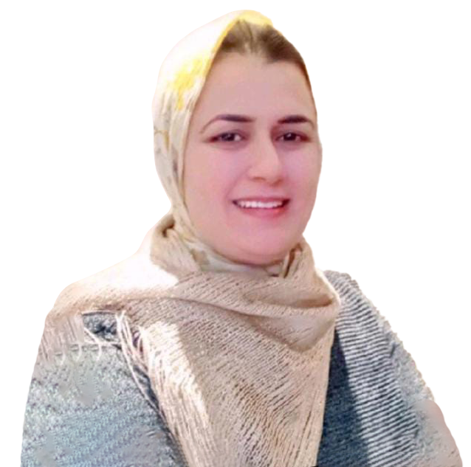





TEAM
Ayman Aljohani
Dr.Malek Channoufi
Imad Alavi
Hilda Ramadan
Dr.Jamilah
Founder & CEO /CFO
CPO
Engineering Manager
Marketing Manager
AI Advisor
Engineering & Construction Tasami Ltd. Founder
Aramco YLAB member
AWS Construction and Facilities
20 years of experience
Ventures Builder
Innovation Leader
Helped build tens of startups
13 years of experience
Details-oriented
Full stack developer
14 years of experience
Worked in Public Relations at Four Seasons Hotels
6 years of experience
Specialized in AI-Driven Data Analytics and Strategic Planning

Slide 15

BUILTOP ASK
Marketing
Senior Hires
37%
18%
45%
Technology
AMOUNT
5 MILLION USD$

Slide 16
Thanks
In the world of construction,
every brick is a piece of creativity,
and every structure is a masterpiece.
Want to reach us?
Email: aaljohani@builtop.com
Phone: +966-548745035

