Slide 1



A Micro Fulfillment Platform
Empowering food brands to scale their sales by unlocking new areas and acquiring new customers at $0.00 Cost
Investment Growth Deck
kitchefy.com
Sep 2023

Slide 2
Kitchefy at a glance …
We are a Micro Fulfillment Platform Empowering food brands to scale their sales by unlocking new areas and acquiring new customers at $0.00 Cost
OUR OFFERING
A ~25% increase in revenue for commercial kitchens through increased utilization rate
A $0.00 set up fee for food brands to join our network of fulfillment partners
Less than 10 days to expand a food brand to a new location
Tech-enabled management of supply chain, operations and quality through our SaaS solution
THE OPPORTUNITY
Commercial kitchens
55,000 commercial kitchens in KSA, with estimated unutilized capacity to fulfill meal delivery orders worth ~US$800M per year
Food brands:
Meal delivery segment in KSA is currently valued at US$8.83B with a CAGR of 9.28% until 2027
About 10% of meal delivery is confectionery and desserts. That is US$883M in market value
REGIONAL PRESENCE
ACHIEVEMENTS
Closed our pre-seed round with $450k raised from angel investors and multiple VC’s in Jordan
Realized an actual monthly revenue of $46,783 in Dec 2022
Obtained business license in KSA and raised $140k from Taqaddam to fund expansion to KSA
FUNDING NEEDS
US$1.2 Million
15%
Jordan
Active
23%
In plan
Sales & Marketing
26%
Other
36%
Saudi Arabia
Technology
Operations

Slide 3






We are solving a two-sided persistent problem
Where brands cannot scale fast, and commercial kitchens have excess capacity and low revenues
Existing High Growth Brands
Sweets, pastries, salads, cold sandwiches, coffee, juices
Delivery limited to within 15km radius from kitchen
Resources are focused on Marketing - NOT fulfillment
Opening a new location is expensive and risky
Solving for the growth and expansion of food brands
Commercial Kitchens
Commercial kitchens naturally concentrated in high demand areas
Utilized at 40% rate on average
Resources are focused on Fulfillment – NOT Marketing
Service 15 km radius only
Solving for increased revenue of the commercial kitchens
The market is now costing 60K USD to open a Cloud/Restaurant/distribution kitchen with 55,000 existing facilities in the kingdom that have overall 60% excess capacity.

Slide 4

After 35,000 orders delivered
We’re seeing three trends happening in the KSA’s e-food-commerce industry which compelled to adjust our market focus
Challenges in Logistics Fulfillment
Ex. A brand in Jeddah takes 1-week delivery to Riyadh and is losing customer base
Massive Underutilized Resources
in commercial kitchens (40% average utilization)
Sales Driven by Aggregators
Brands are only available to 15 Km radius

Slide 5












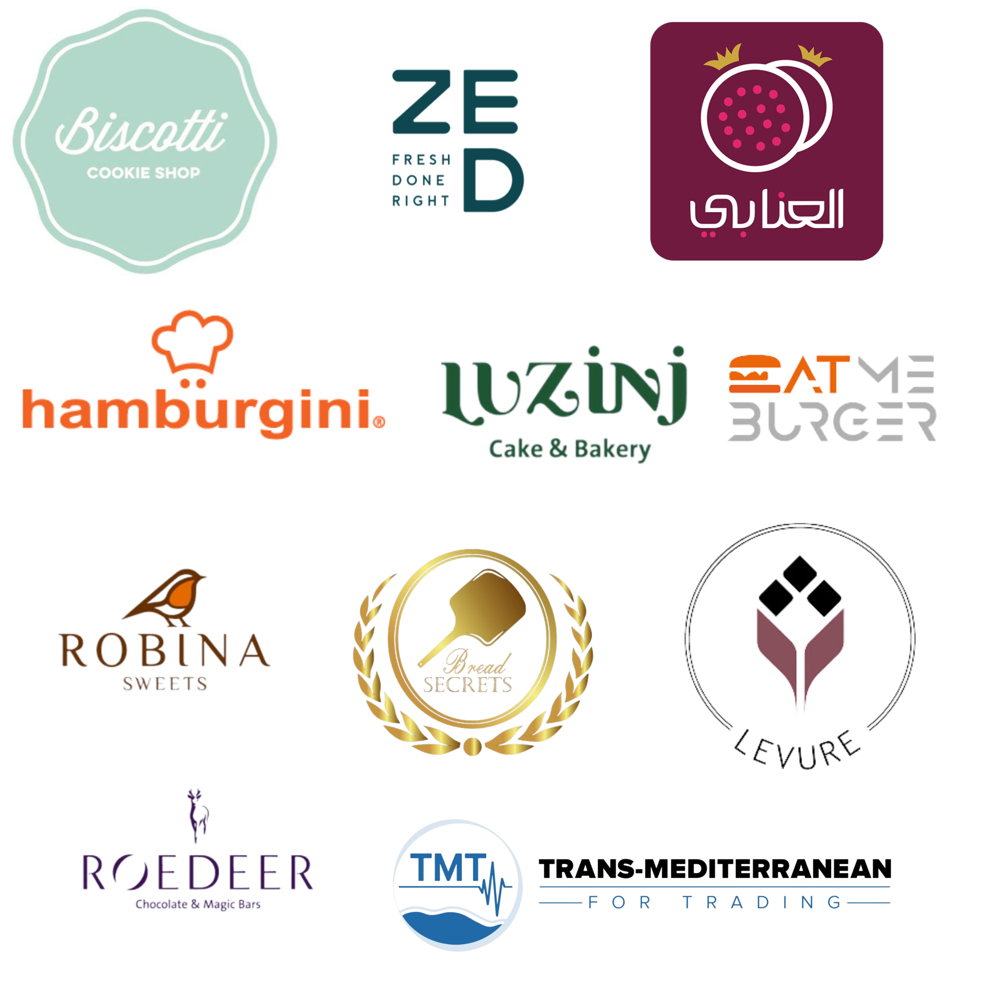

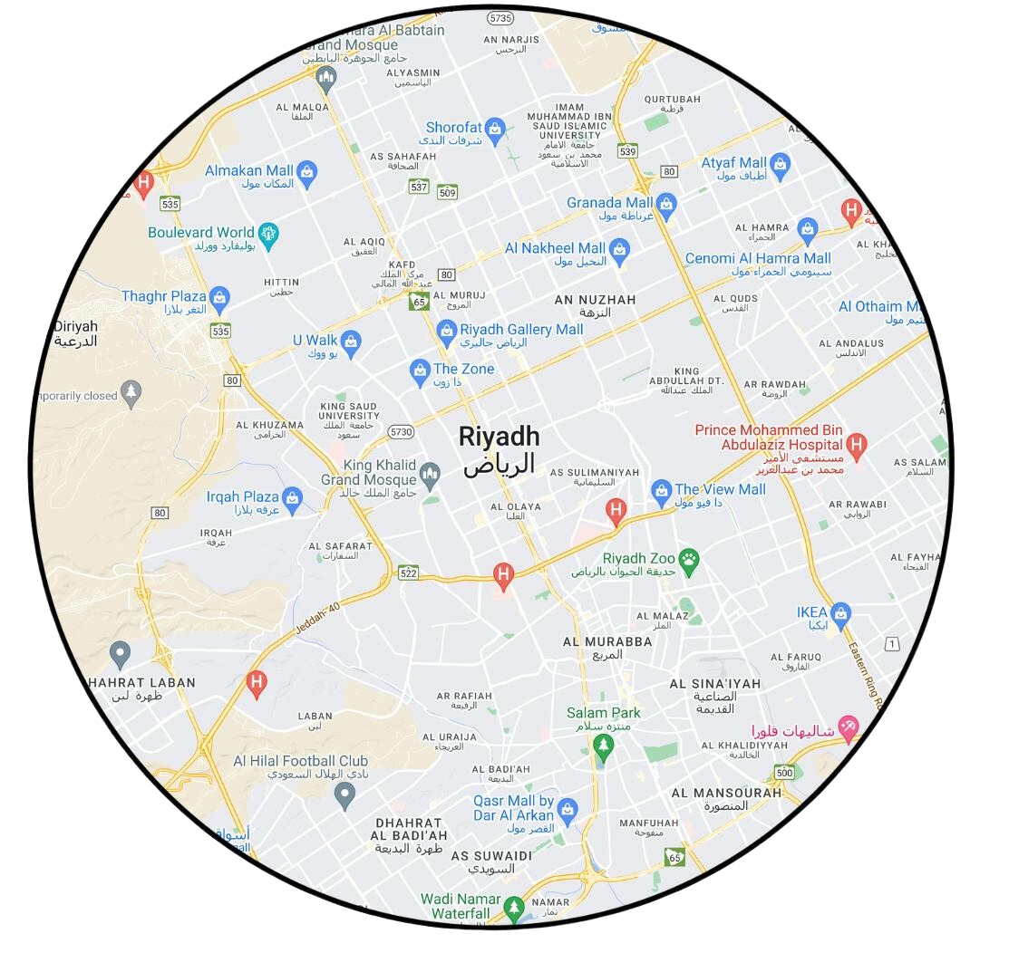


Solution: A Micro Fulfillment Platform
Kitchefy offers a solution to increase utilization of commercial kitchens through converting them into fulfillment partners for food brands
Existing Staff
Extra Profit for the Kitchen
+ 20%
Existing brands from the market with high demand
Existing Equipment
Existing Utilities Cost and Rent
A new delivery
location

Slide 6
Having this coverage 8 days after a food brand is launched is a dream for any brand owner….But how?
An active location within 15 km of high demand points
Lower preparation time and faster delivery
$0.00 Set up cost
Happy customer = Returning customer

Slide 7



KSA’s first Micro Fulfillment Platform (MFP)
We make the scaling process seamless for food brands by eliminating the barriers to setting up a new fulfillment location
How does it work?
Step 1: We sign on brands that want to scale their operations and reach new customers
Step 2: We match them to 120+ kitchens we’ve signed up (from existing hotels, and restaurants, cafes) who have underutilized capacity
Step 3: We help brands onboard to our digital platform and tap into our network of kitchens with quality control, inventory management, incident management, payment reconciliation.
Value
proposition:
10X number of locations
100X
lower cost
14X faster : Starting in 8 days rather than 16 weeks for fit out

Slide 8
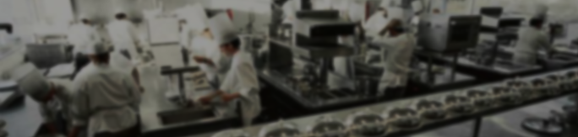

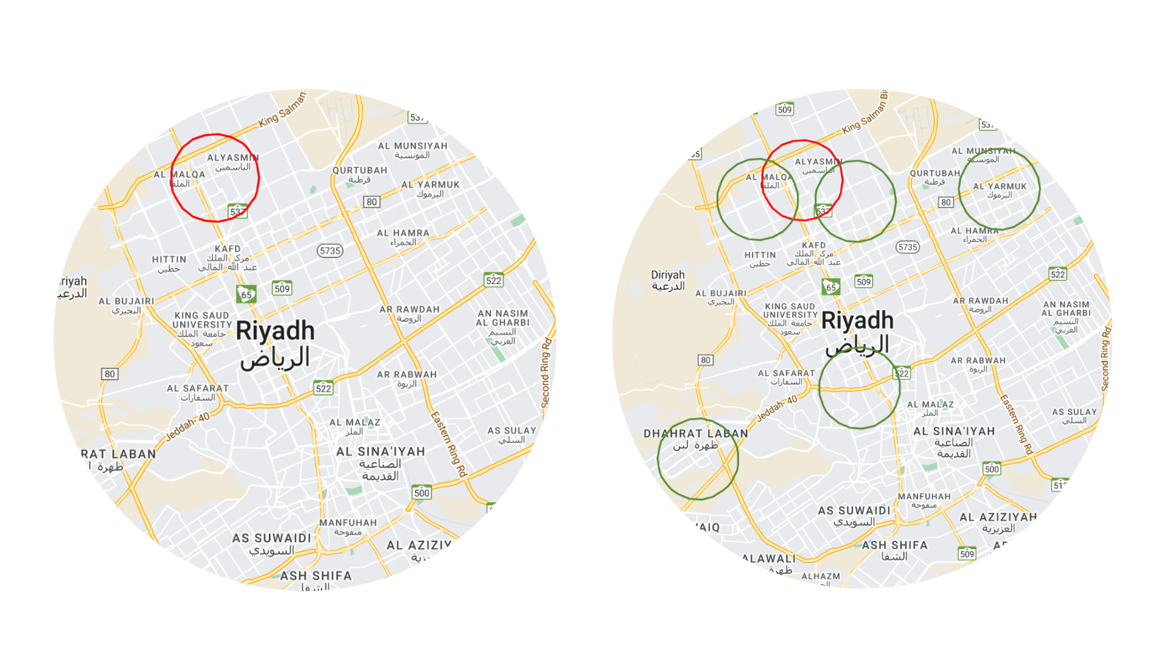
A case study:
Activating 5 new locations and unlocking $22K in additional revenue for ZED
During
Outbound lead (scraping data of the web)
Called them and invited them to a demo
Signed a contract for 5 new locations
Onboarding their brand to took 8 days
The total cost of expansion costed them $0.00
Potentially unlocking $22K in additional revenue per month
Before
ZED sells ready-made sandwiches and salads
28 restaurant branches
It took them 7 years to build up this network
Investment is $60K per branch
Each branch is still operating at 60% capacity
Their fundamental problem is opening branches in new cities at lower cost

Slide 9

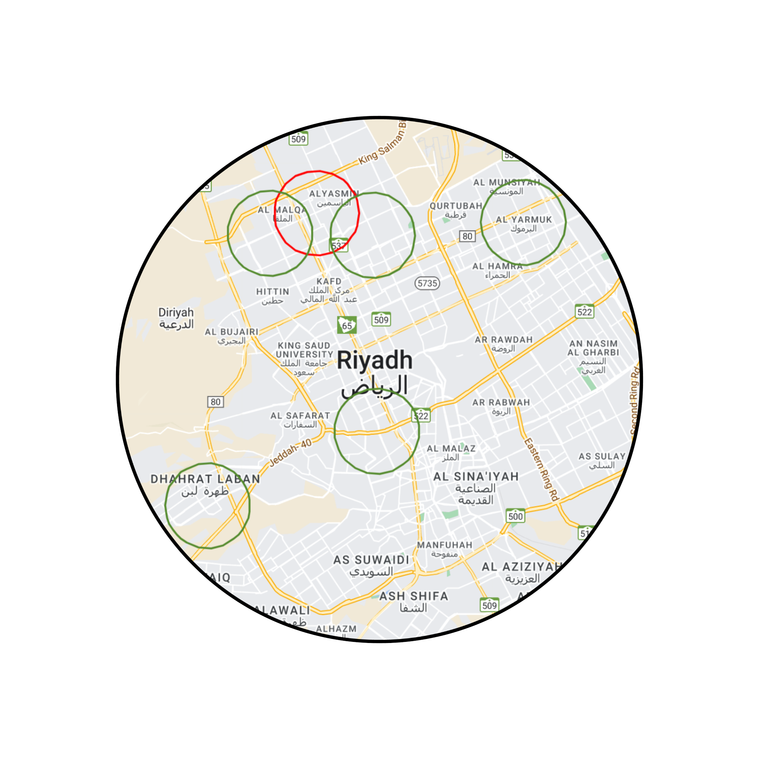
A case study:
A case study:
Before on Monday
Zero locations
Zero access to customers
After on Tuesday
7 locations
2 million people

Slide 10
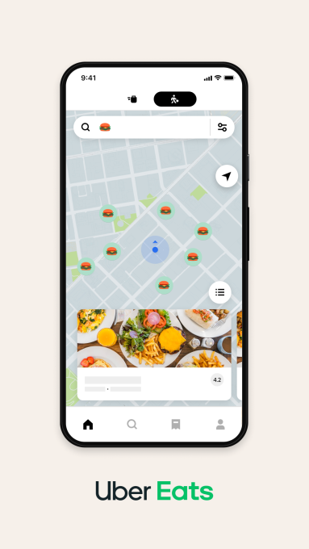
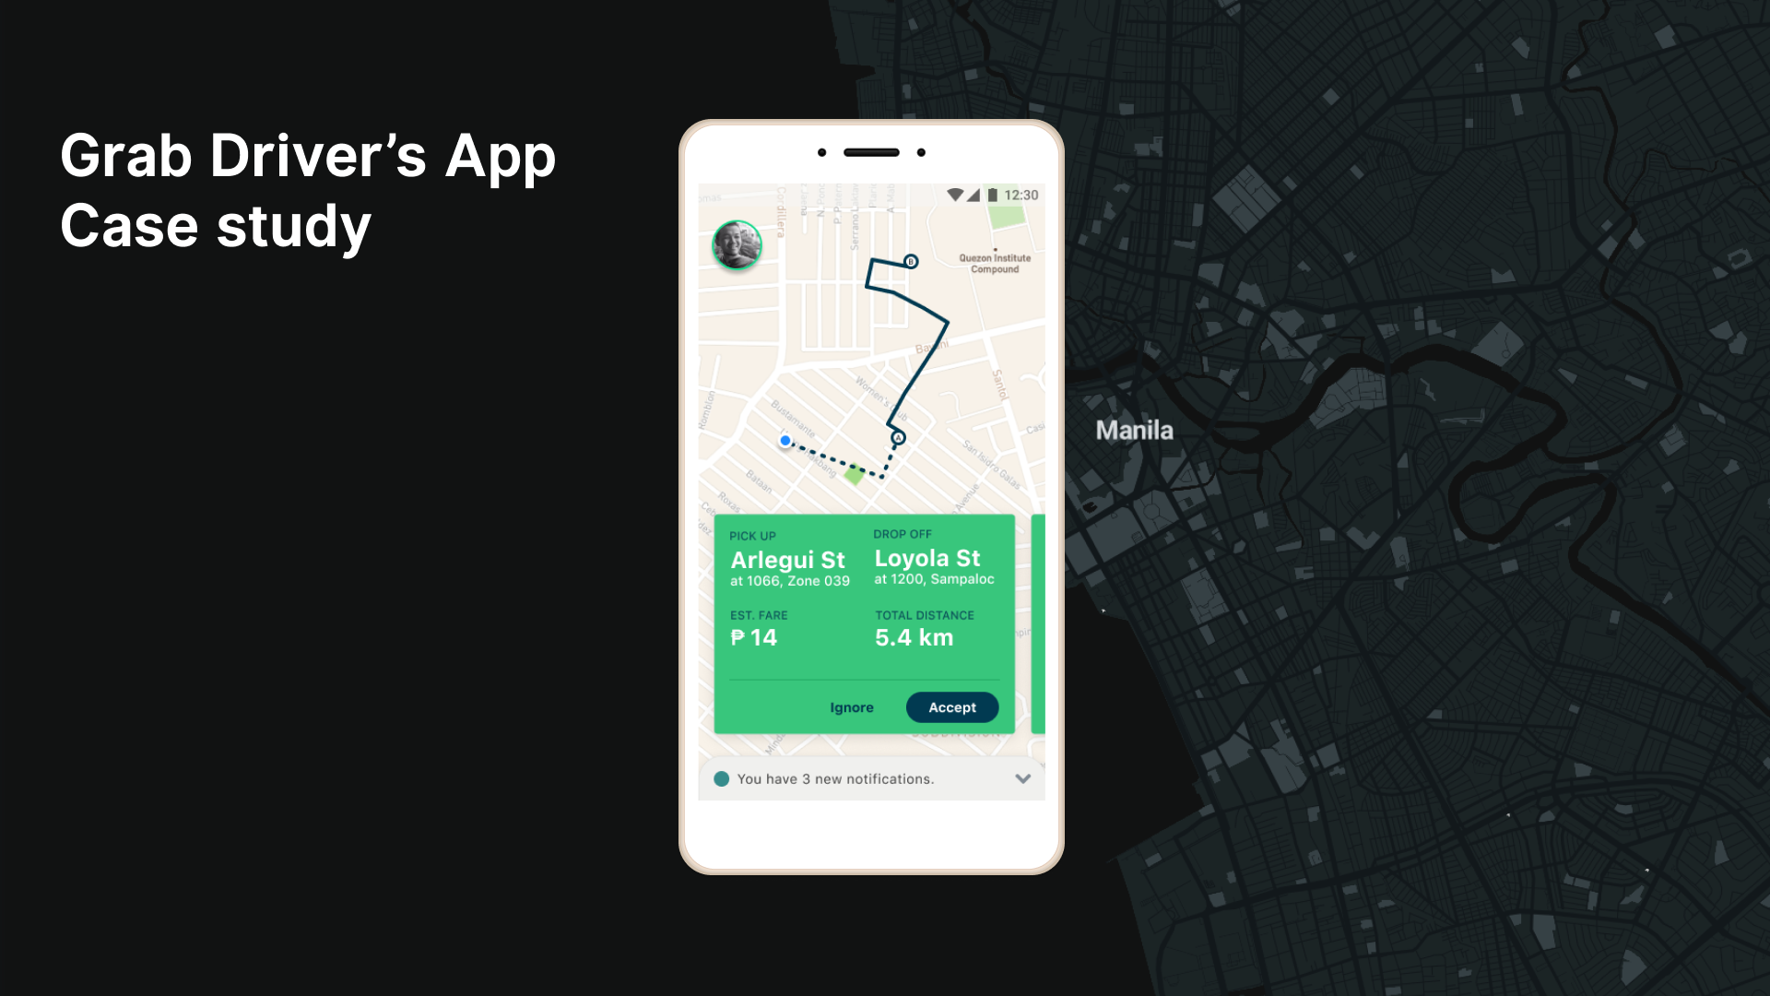

A simple, scalable, validated business model
Our model maximizes the share of revenue for the brand owners and commercial kitchens, while ensuring profitability through focusing on high demand centers
Our average fulfillment partner will get an additional 450 orders per month generated through the aggregator app
= An additional 3,150 SAR of revenue per month
Brand Owner
Kitchefy
Fulfillment Partner (Kitchen)

Slide 11

Operating in a massive, $14.29 Billion by 2027
Our conservative estimation of the market size in terms of gourmet and confectionery food delivery, reveals it to be close to US$883M
Revenue from meal delivery is expected to show an annual growth rate (CAGR 2023-2027) of 9.28%, resulting in a projected market volume of US$14.29B by 2027
84% of the food delivery orders are made directly between the customer and the restaurant
10% of customers order their meals with desserts as a global benchmark
Customers who order desserts through the app usually do it for a group (parties, family dinner, special occasions). The order value tends to be double
Online Food Delivery is valued at $10B
Meal Delivery is valued at 8.83B
10% order their meals with desserts: $883M (TAM)
Source: Statista 2023

Slide 12


We have a differentiated competitive strategy
Strengths lie in KSA, scalable business model, focused customer segments e-commerce brands
Inventory management tech
Name:
Characteristics: Assets free, vast and fast onboarding, food prep capability, sampling and FMCG.
KSA
Locations
(120)
E-commerce (nonfood)
Grocery Commerce (pre-prepped)
Name:
Characteristics: Physical micro warehousing, high capital cost
Scalable
business model
E-commerce food brands
(light prep - sweet, sandwiches, juices, etc)
Name:
Characteristics: Physical micro warehousing, high capital cost
Quality Management
Development Trajectories of Kitchefy SaaS

Slide 13

Future streams of revenue
FMCG Sampling
Once you have the network the opportunities are endless
FMCG Brands
E-commerce Fulfillment

Slide 14
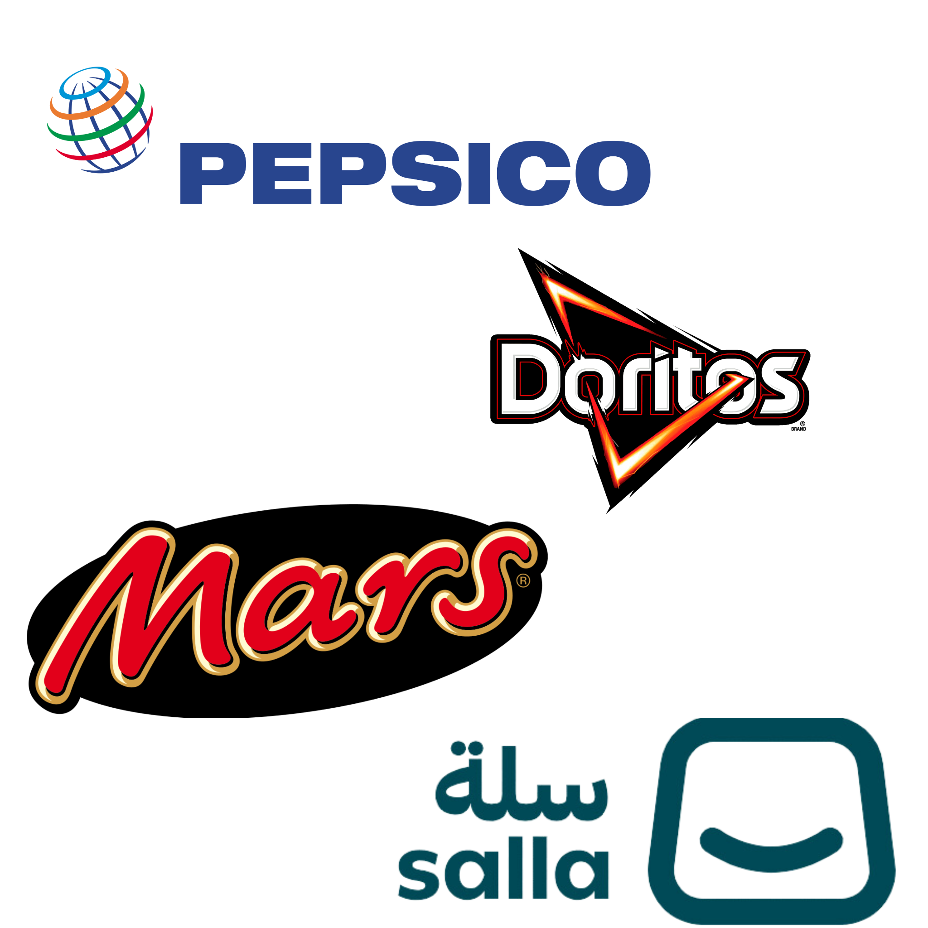
In the Pipeline
Brands & FPs
FMCG brands & Food Commerce Partners

Slide 15
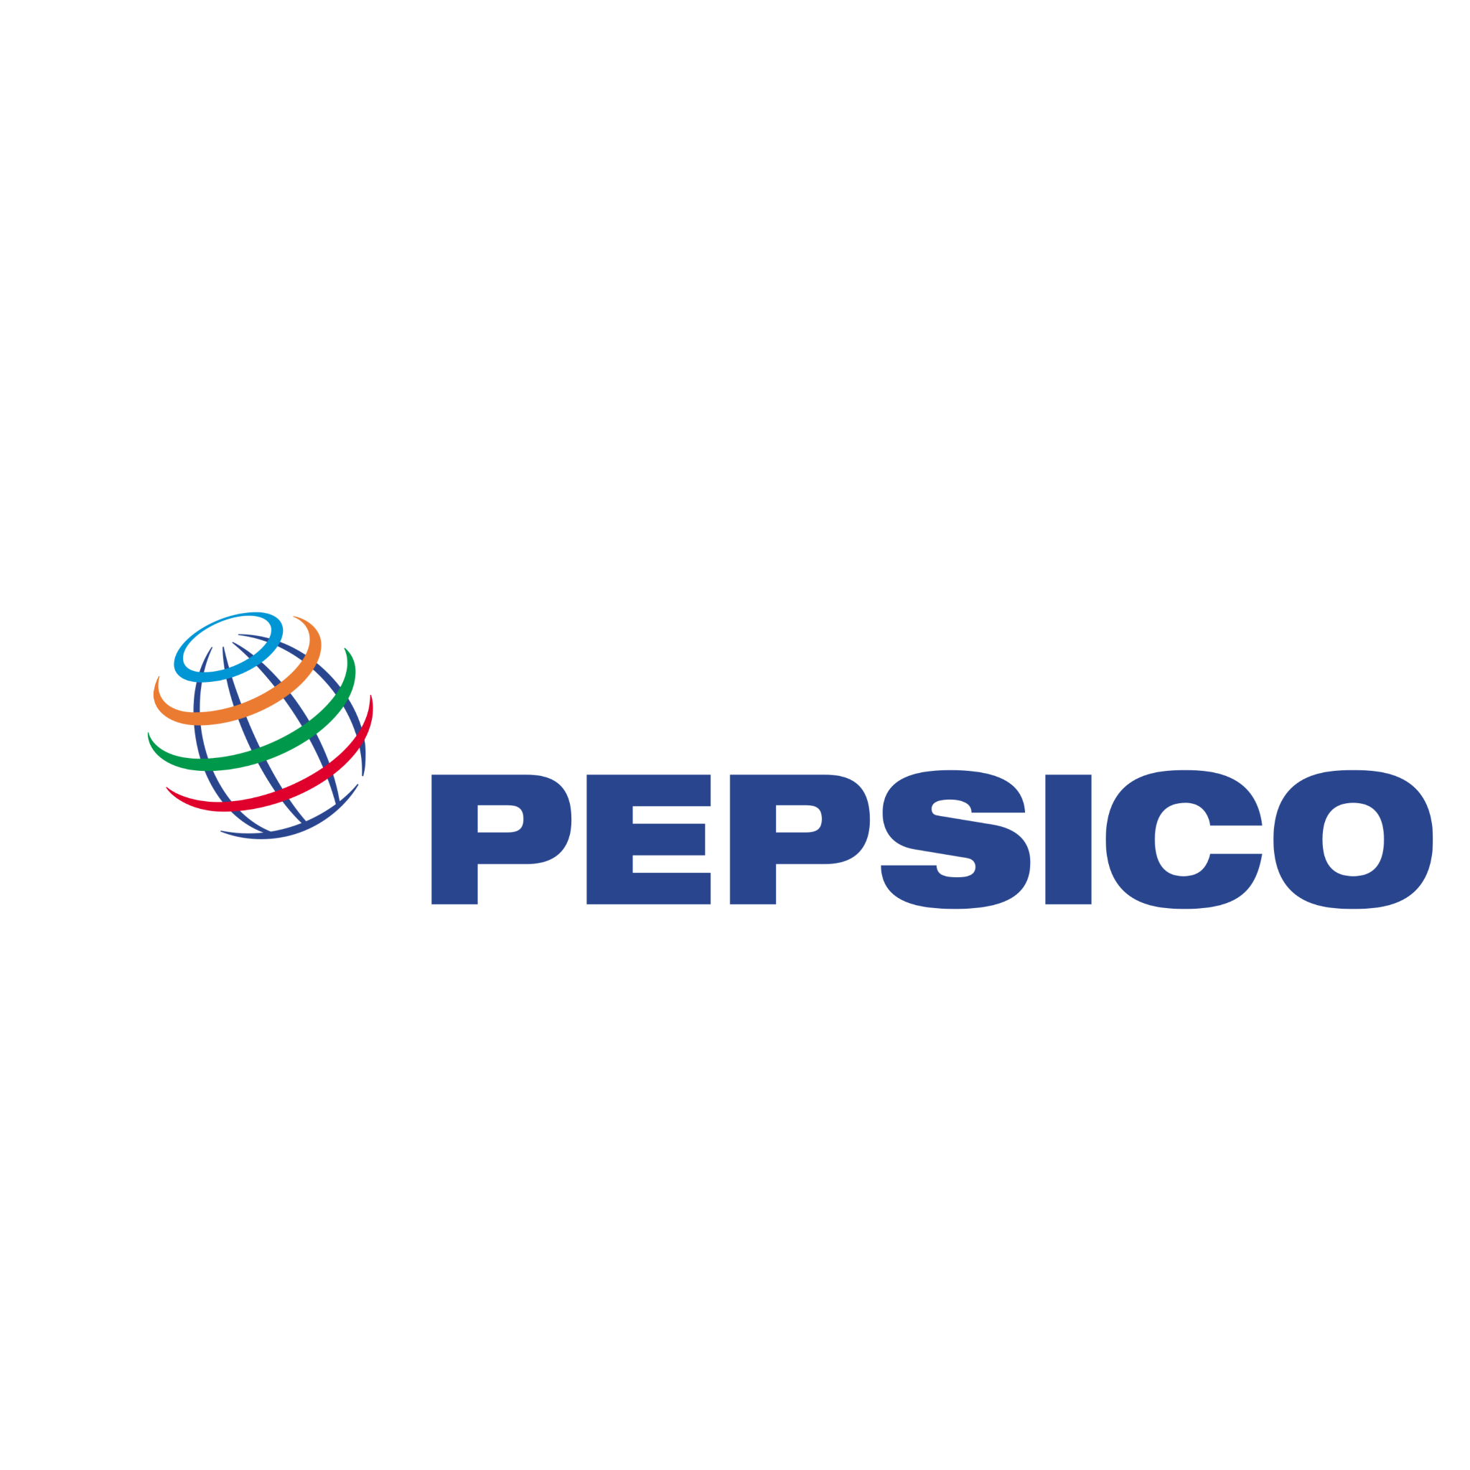
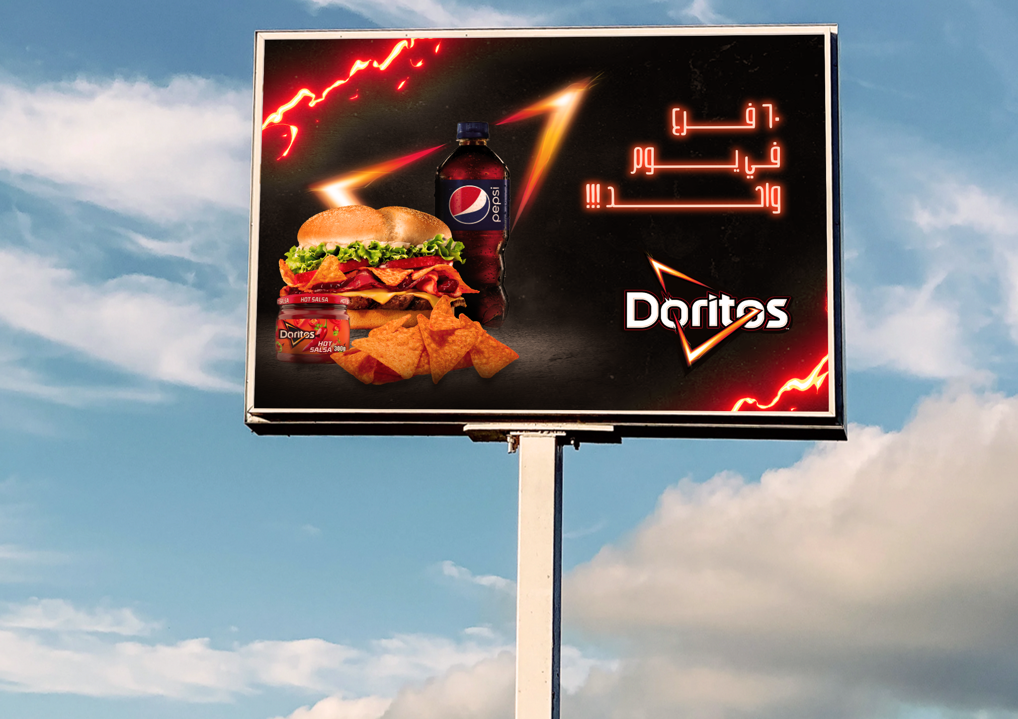
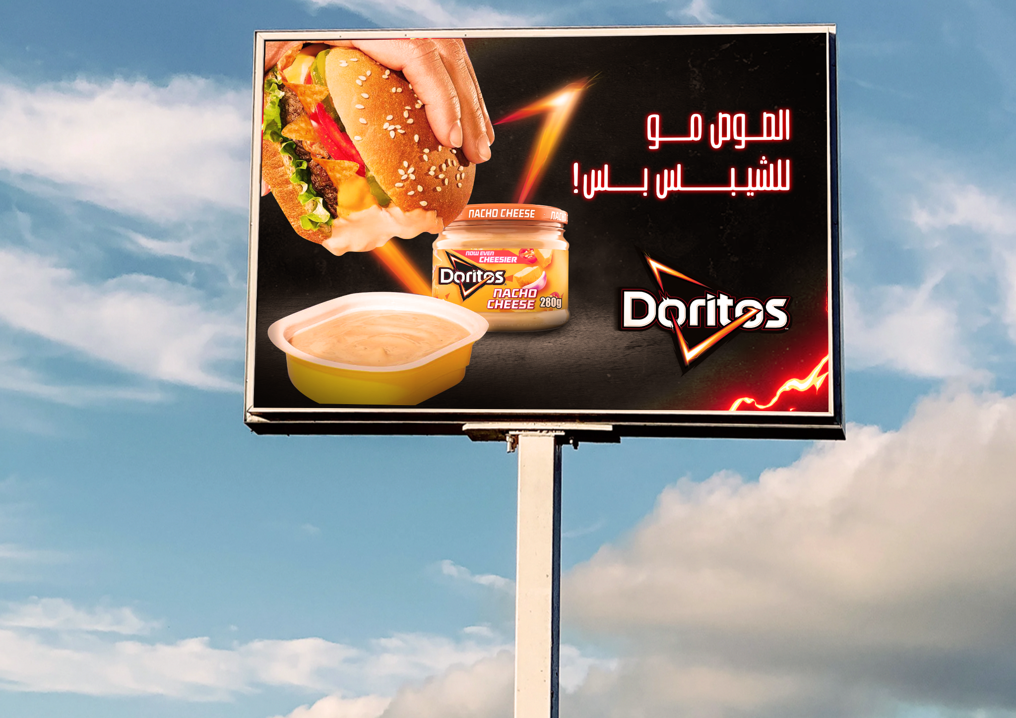
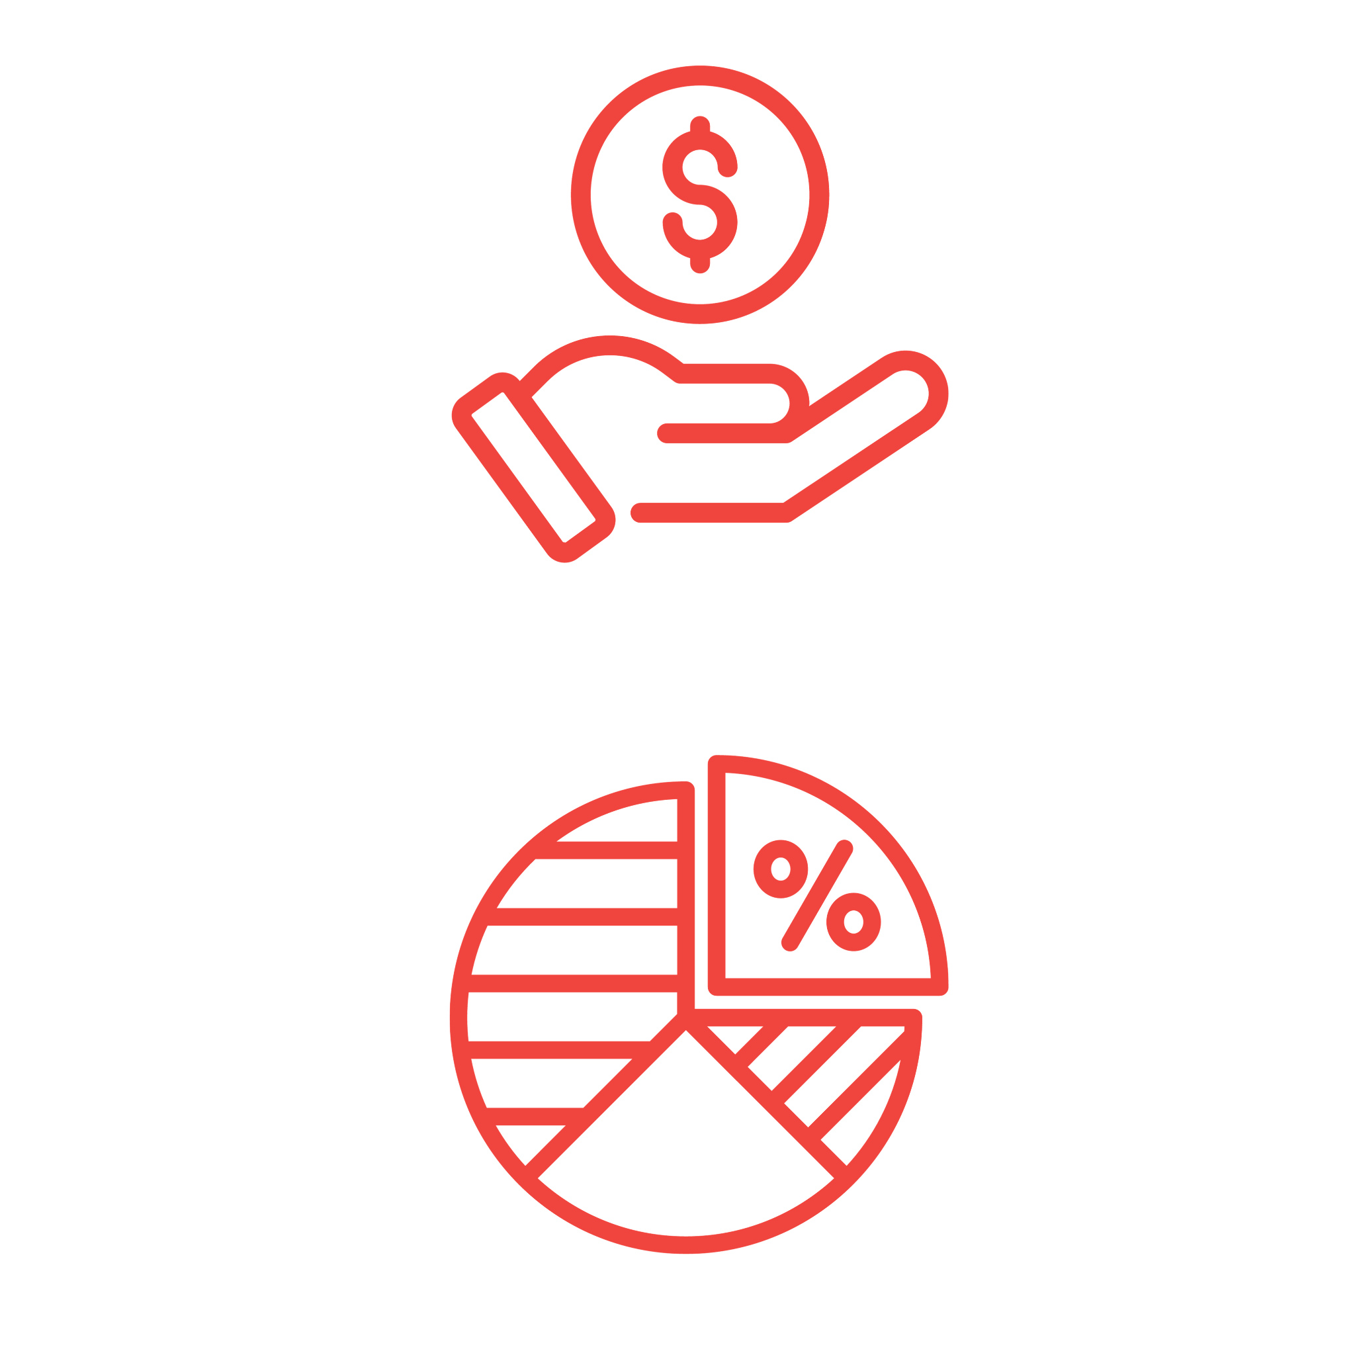
We are in advanced talks with
60 locations
$300,000 upfront payment
5% out of total sales

Slide 16
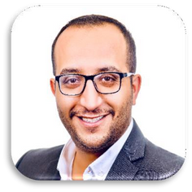



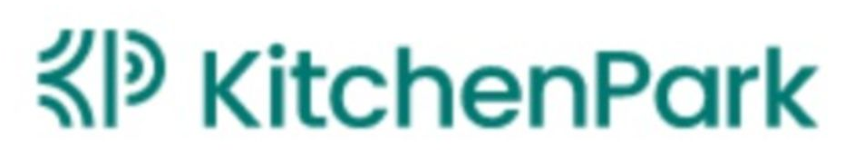


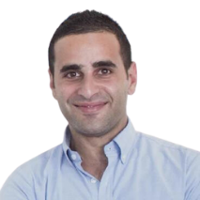



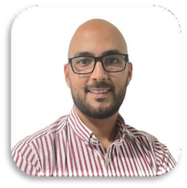




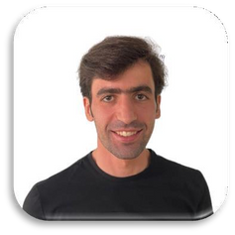


Our experienced, mission-driven team
Our team brings years of blended experience in high growth start ups, marketing, operations and financial services
Management Team
Advisors
Marwan Abu Sakha
Co-founder & CEO | 2 Startups
10+ years of entrepreneurial experience with a focus on high growth start ups
Zeid Hreish
Regional MENA Manager-CloudKitchens
Regional General Manager-Uber
Abdullah Alabsi
Co-founder & CFO
5+ years of financial consulting experience at Deloitte
Zaid Husban
Founder and CEO-POS Rocket
CSO and Advisor- Foodics
Laith Alkilani
COO
3 Startups | One exit from logistics
9+ years in start up experience focused on delivery operations
Partners
Partners
Abdulrahman Ghodayah
CTO | 3 Startups
12+ years in software development and data science in Tech start-ups

Slide 17
Our roadmap to growth
With a disruptive strategy, we are set on capturing the KSA market first and replicating our success in the rest of GCC and Europe
 | 2021-2022 Pre-Seed: $450,000 Focus on Validation | 2023-2024 Raising for Seed: $1.2M /$ 400K Left ($200K Committed,,$ 200K Left) Focus on Expansion and Product | 2026-2030 Series A $15m+ Focus on scale markets + ecommerce
Investors | Oasis500, ISSF, Beyond Capital, TAQADAM | TAQADAM, Lamarka, Angel Investors
Markets | Jordan | KSA | GCC/Europe
Restaurants Brands Orders | Old Model: Kitechfy Virtual Kitchen/Own Brands 16 | 4 Own brands | 33K | New model: Kitchefy Virtual Retail/Existing brands 120 | 7 existing | Launching October | Virtual Retail/Existing brands 800 | 80 | 1.5 Million
Learning | We pivoted away from own brands because unit economics didn’t add up We proved the need of virtual kitchens High retention We proved quality control validation | Unit economics - Margins Scalability - brands onboard in 7 days Validating also e-commerce (small sample size) | Ecommerce scale Nano warehousing tech
Product life-stage | V1: Order integration 3rd party omni channel Menu changes Financial reconciliation | V2: Digital distribution Quality management Inventory management LMS | V3: Nano Warehousing Logistics network Stock management

Slide 18
Raising $1.2M, $800K secured, $200K committed
Focused in growing 4 key areas - sales, other, operations & product development
15% - Sales & Marketing development
Sign up new customers
Lead generation & business development
Marketing & design
On ground sales
Partnerships
Sales & Marketing
Operations
15%
26% - Other
Other salaries
Travel expense
Events
23%
26%
36% - Technology & Product development
Create a better product experience
Improved payment partner integrations
MENA & additional product expansion
App, front-end, back-end development
Other
36%
23% - Operations development
Build operations for scale
G-suite & other operational tools
Legal, Finance, HR capabilities
General overheads
Payrolls, medical insurance, social securities
Technology
18-month runway

Slide 19
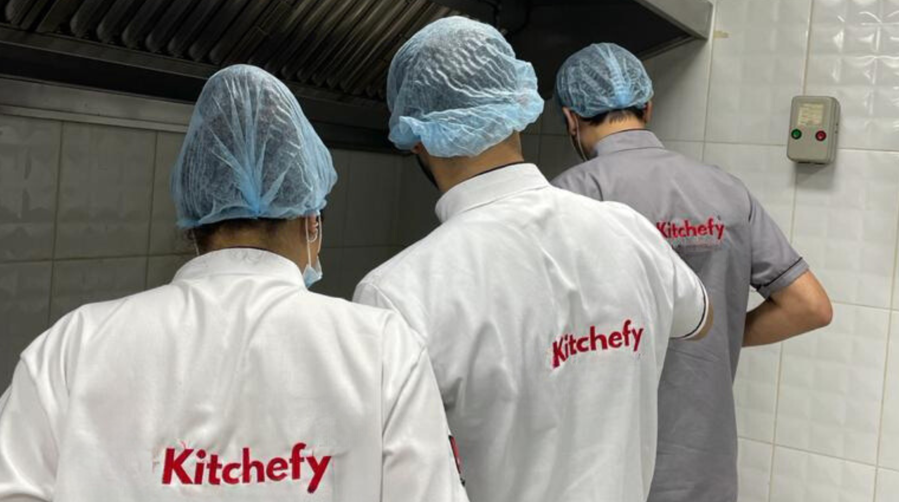
Thank you!
We are looking for investors with experience in FMCG, Logistics, F&B
or investors who can add strategic value to the company
Marwan Abu Sakha
Co-founder & CEO
Marwan@kitchefy.com
+962 79 20 82000
Investment Growth Deck
kitchefy.com
Sep 2023

