Slide 1
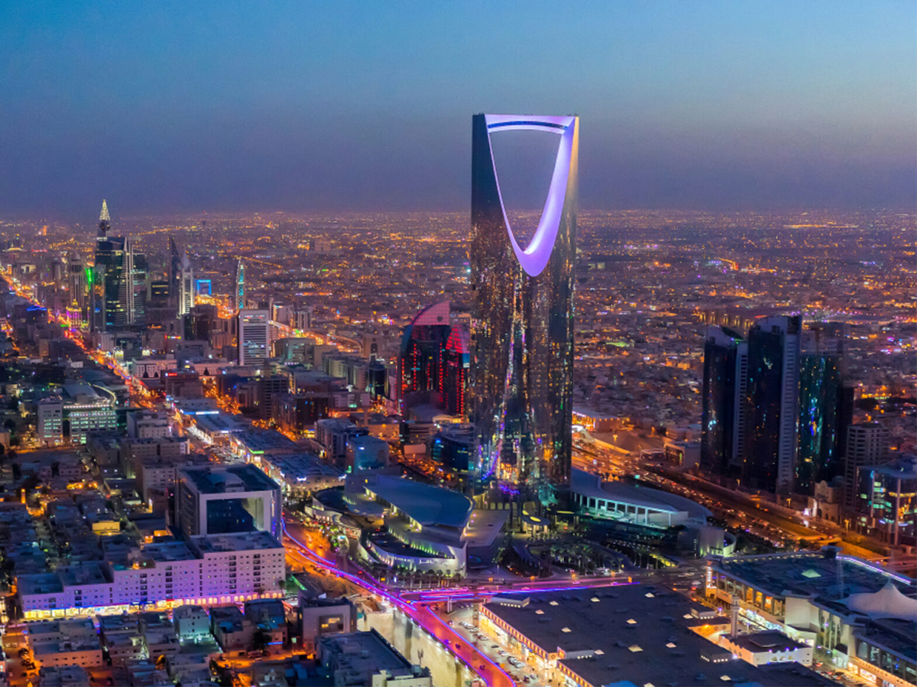




Comprehensive solution for a seamless digital beauty experience
SHAFRAH APP
www.Shafarh.net

Slide 2


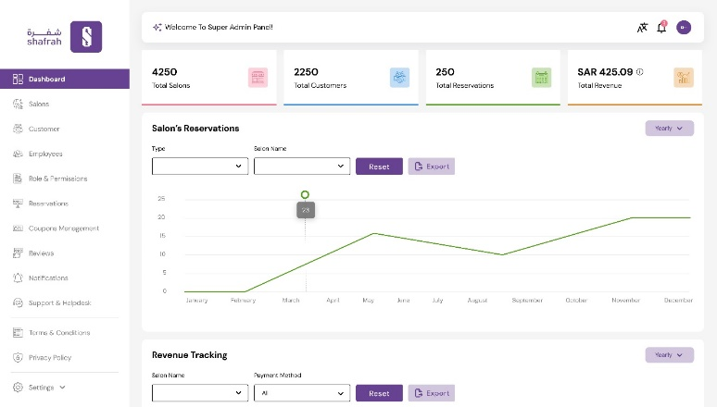
Comprehensive Solution for a Seamless Digital Beauty Experience
SHAFRAH APP
www.Shafarh.net

Slide 3










Limited Accessibility
Customers often struggle to find salons that meet their specific needs and preferences.
Salon Management
Overseeing all aspects of salon operations, including staff management, appointments, finances, customer service, and marketing.
Limited Accessibility
Customers often struggle to find salons that meet their specific needs and preferences.
Limited Accessibility
Customers often struggle to find salons that meet their specific needs and preferences.
Comprehensive solution for a seamless digital beauty experience
Lack of Trustworthy Information
The market does not provide comprehensive and reliable details about salons, leaving customers unsure about their choices.
Daily Salon Operations
Managing daily tasks within the salon and dealing with appointments efficiently.
is a digital platform designed to revolutionize the salon industry by offering seamless booking experiences for customers, and comprehensive management tools for salon owners.
We are bridging the gap between clients and salons, ensuring transparency, convenience, and efficiency for both sides.
Time Wastage
Customers are forced to wait long periods to secure appointments at salons, making the process inconvenient.
Accounting and Financial Tracking
Handling financial matters, managing accounts, and tracking revenue.
Inefficient Booking Processes
Many salons rely on outdated or complex booking systems, requiring customers to call or visit in person to schedule appointments.
Attracting New Clients
Reaching potential clients and increasing the visibility of the salon.
SHAFRAH APP
www.Shafarh.net

Slide 4
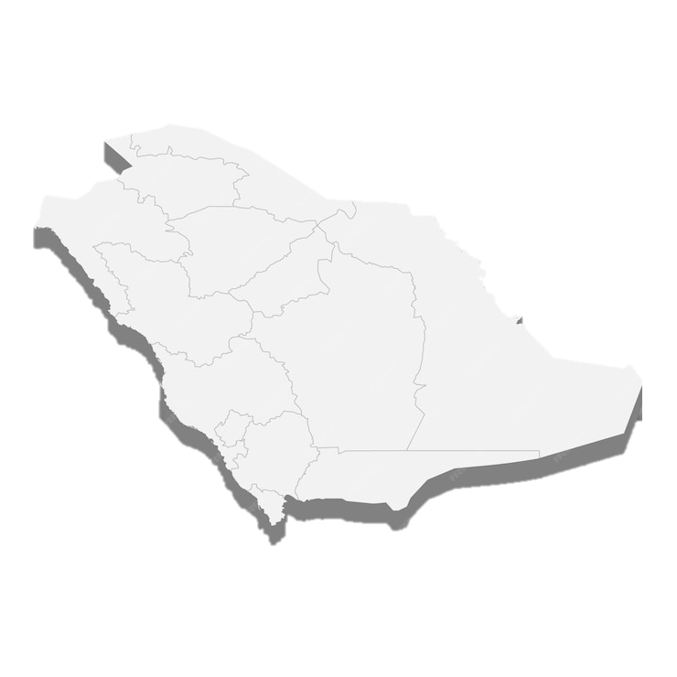
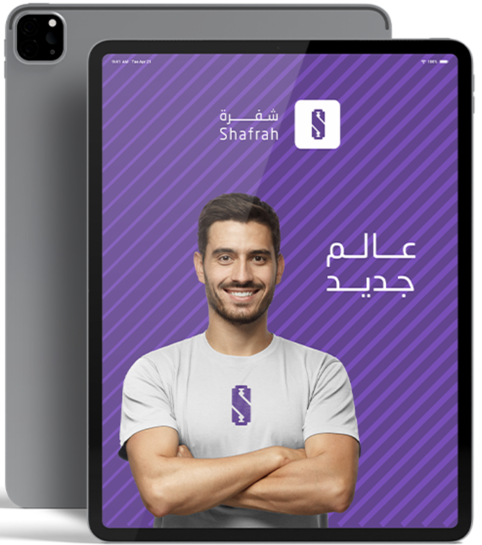
SHAFAH APP
www.Shafarh.net
Our vision is to be a leading platform in salon management and personal care, contributing in raising the quality of life in Saudi Arabia by setting new standards of excellence, innovation, and customer satisfaction in the beauty industry, while fostering sustainability and aligning with Saudi Vision 2030.
Vision

Slide 5
Solutions
Customers
Partners
Limited Accessibility
Customers often struggle to find salons that meet their specific needs and preferences.
Salon Management
Overseeing all aspects of salon operations, including staff management, appointments, finances, customer service, and marketing.
Limited Accessibility
Customers often struggle to find salons that meet their specific needs and preferences.
Limited Accessibility
Customers often struggle to find salons that meet their specific needs and preferences.
Lack of Trustworthy Information
The market does not provide comprehensive and reliable details about salons, leaving customers unsure about their choices.
Daily Salon Operations
Managing daily tasks within the salon and dealing with appointments efficiently.
Challenges
Time Wastage
Customers are forced to wait long periods to secure appointments at salons, making the process inconvenient.
Accounting and Financial Tracking
Handling financial matters, managing accounts, and tracking revenue.
Inefficient Booking Processes
Many salons rely on outdated or complex booking systems, requiring customers to call or visit in person to schedule appointments.
Attracting New Clients
Reaching potential clients and increasing the visibility of the salon.
SHAFRAH APP
www.Shafarh.net

Slide 6

Challenges
Salon Management
Overseeing all aspects of salon operations, including staff management, appointments, finances, customer service, and marketing.
Limited Accessibility
Customers often struggle to find salons that meet their specific needs and preferences.
Solutions
Daily Salon Operations
Managing daily tasks within the salon and dealing with appointments efficiently.
Salon management system
All-in-one platform designed to streamline salon operations and enhance customer experiences.
Accounting and Financial Tracking
Handling financial matters, managing accounts, and tracking revenue.
Attracting New Clients
Reaching potential clients and increasing the visibility of the salon.
Customer App
SHAFRAH APP
www.Shafarh.net

Slide 7






App
System
Streamlined Booking System
Discovering New Salons
Search for salons based on location,
Offers an intuitive platform for managing appointments and reducing booking complexities.
Excellence in user experience and design
Management Tools
services offered, customer ratings, and reviews.
Simplifies staff management, scheduling, and daily operations without any additional costs.
Customer Engagement
Fast booking suitable salons
An elegant and user-friendly interface that ensures user comfort and smooth interaction
Select the desired date and time for the service via App,
Provides features to communicate effectively with clients, improving customer retention and satisfaction.
Transparent Reviews and Ratings
Financial Tracking
eliminating the need for phone calls, personal visits, or waiting.
Helps customers make informed decisions based on the experiences of others.
Enables accurate monitoring of revenue and expenses, helping salons stay financially organized.
Safety and credibility
Increased Visibility
All salons are reliable ,
Connects salons with new customers through a centralized platform, boosting their reach and business growth.
as comprehensive information about them is available to customers.
SHAFRAH APP
www.Shafarh.net

Slide 8



Business Model
Charging a fixed fee to the end customer for each Booking
End User “ Customer “
Booking Service
Salon
Service Provider
SHAFRAH APP
www.Shafarh.net

Slide 9

Market size
0
1 M
10 M
50 M
100 M
500 M
1 B
1.5 B
0
1,000
3,000
5,000
7,000
9,000
15,000
19,000
20,000+
$
Salons
Total Revenue
In Saudi Arabia
SHAFRAH APP
www.Shafarh.net

Slide 10




0,000
1,000
3,000
5,000
7,000
9,000
15,000
19,000
20,000+
0
1 M
10 M
50 M
100 M
500 M
1 B
1.5 B
Market size
$
Salons
Total Revenue
In Saudi Arabia
SHAFRAH APP
www.Shafarh.net

Slide 11






Competitors
Cloud-based salon management
Customer Services
Partner Support
Located in Kingdom
App for Customers
Cost / Subscription
Free
750$
Annually
99$
Monthly
4.9%+ 0.75 per/ Res.
SHAFRAH APP
www.Shafarh.net

Slide 12

Financial Projections
50,000,000
45,600,000
40,000,000
30,000,000
20,000,000
14,600,000
10,000,000
8,000,000
5,000,000
3,320,000
320,500
0
2025
2026
2027
2028
2029
Annual Revenue $
SHAFRAH APP
www.Shafarh.net

Slide 13
SHAFRAH APP
www.Shafarh.net
Investment
1,100,000$
Asks for
$3,000 Others
15%
$80,000
Operation
$147,000
Administration
$160,000
Developments
15%
60%
8%
$605,000
Marketing & Sales
2%

Slide 14

SHAFRAH APP
www.Shafarh.net
15%
Investment
8%
$200,500
Administration
15%
2%
$88,000
Operation
$170,000
Developments
Asks for
$15,000 Others
1,100,000$
60%
$607,500
Marketing & Sales

Slide 15

SHAFRAH APP
www.Shafarh.net
Corporate Social Responsibility
Future Plans
Signing partnerships with multiple salons.
Capturing new customer segments.
Enhancing user experience and interface design
Increasing bookings through the application.

Slide 16









SHAFRAH APP
www.Shafarh.net
Team
Mohammed Alwehaibi
Founder & CEO
Ibrahim Alzuaybir
CTO
Sara Almothin
Marketing Manager
Lea Alwehaibi
Sales Manager
Abdulkreem Aljasser
Finance Consultant
5 Years experience in Leadership & Management
6 Years experience in Software Developments
5 Years experience in Marketing & Graphic Design
4 Years experience in Sales & Marketing
5 Years experience in Finance

Slide 17






SHAFRAH APP
www.Shafarh.net
  Shafrah is not just a tool; it is a success partner driving the sustainability of the salon industry.
Khobar, Saudi Arabia
Contact@shafrah.net
+966 50 614 4166
www.shafrah.net

