Slide 1

PITCH DECK
2025

Slide 2
01
About us

Slide 3

Falack is a next-generation social media platform designed to empower users with complete control over their digital experience.
Inspired by the brilliance of the stars, Falack allows you to shape your journey by deciding what you want to see, share, and explore.
Focusing on meaningful connections and personalized content, Falack puts you at the center of your universe, enabling you to navigate your social space with clarity and confidence.
It’s not just a platform; it’s your gateway to a more intuitive and engaging world of communication.

Slide 4
02
Problem Statement

Slide 5
1
2
3
Shallow identity representation
Lack of focus on personal growth
Homogeneous
content discovery
4
5
6
Passive
engagement metrics
Disconnected
digital footprint
No real-time collective goal accomplishment

Slide 6
03
Solution Features

Slide 7
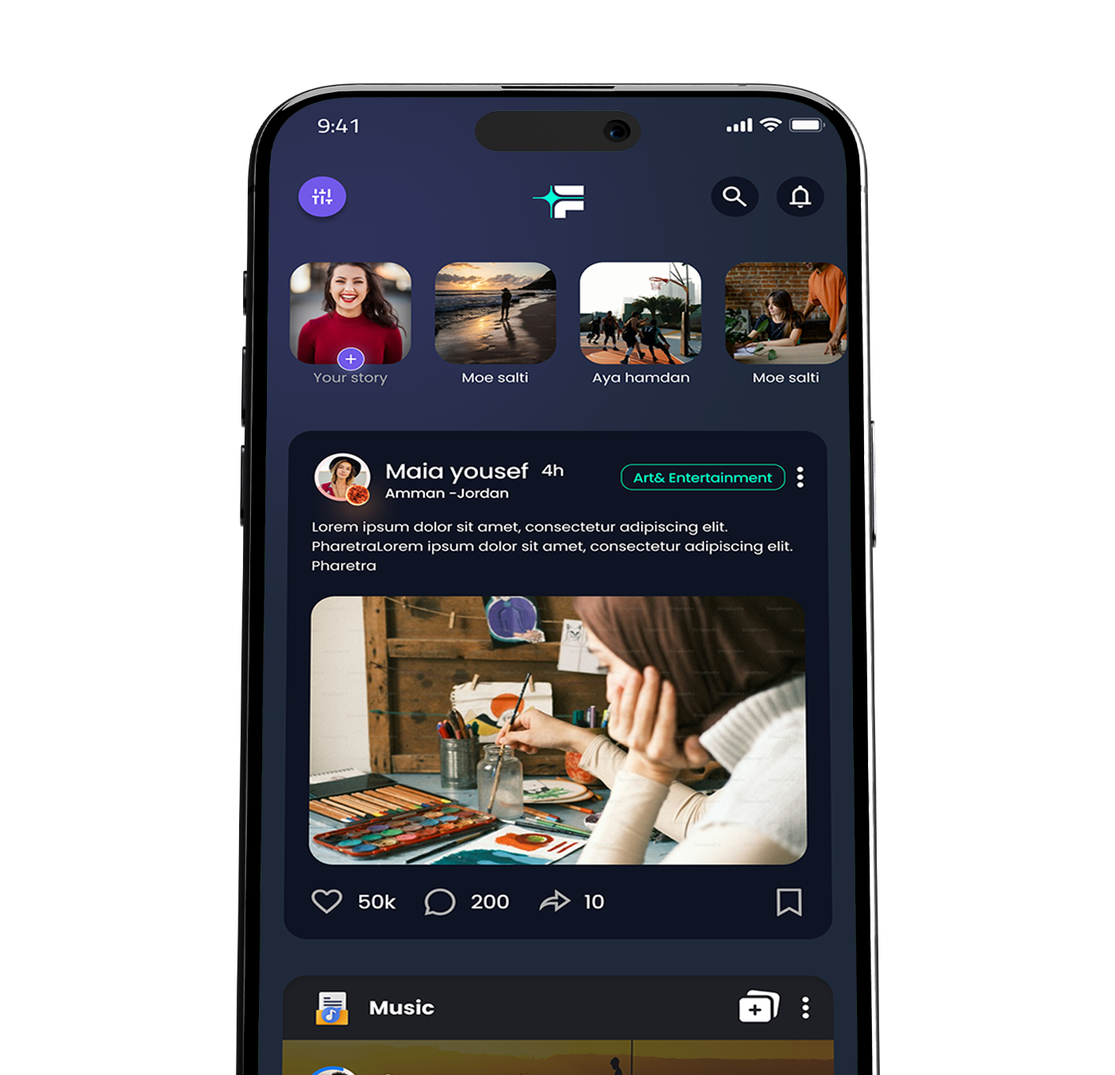
Badges
F
A
Encryption (NFT)
L
Book Reel
A
Collaboration
C
Copyright
K
Content Filtration

Slide 8
Market Opportunities
04

Slide 9
Market size and trends
Market Size
The social media ad spending is estimated at approximately 63M JOD (236m SAR) in 2024, and it is expected to grow at a rate of 10.93%, reaching 100m JOD (375 SAR) in 2029.
Number of user in social media advertising is expected to reach 1.1M in 2029
Market Trends
- Rise of Influencer Culture*
The ability of influencers to drive engagement offers a new marketing channel for M&E companies. Collaborations with influencers can enhance content visibility and consumer trust.
- Generative AI personalization**
consumers are increasingly seeking personalized experiences that cater to their specific interests and preferences
* Statista
**Abstract from digital media trends- Dilliote

Slide 10
Market Difficulties
High Subscriber Churn Rates
The strong competitiveness of other entertainment tools makes it very hard to retain the users.
Content Saturation
The big amount of content generated on a daily basis makes it harder on smaller platform to generate and retain big number of users.

Slide 11
05
Revenues
& Funds

Slide 12
Expected revenues
& targeted fund
Item | Value
Runway period | 12 months after MVP
Targeted market share | 0.25% of Jordanian market
Targeted Revenues | 160k JOD (600k SAR)
Funding Item | Value
HR requirements | 22k JOD (83k SAR)
Marketing Requirements | 50K JOD (187k SAR)
Research Requirements | 3K JOD (11k SAR)
Total 75K JOD (280K SAR)

Slide 13
06
User Benefits

Slide 14
Digital Engagement with Purpose
Tailored & Engaging Feed
Smart curation delivers relevant content with a badge system that boosts meaningful participation.
Substance Over Noise
No gossip, no fluff—every post enriches knowledge and experience.
Positive Community
An uplifting space that inspires personal and intellectual growth.
Insightful & Dynamic Content
Engaging book reels, expert talks, and interactive challenges keep users learning.

Slide 15
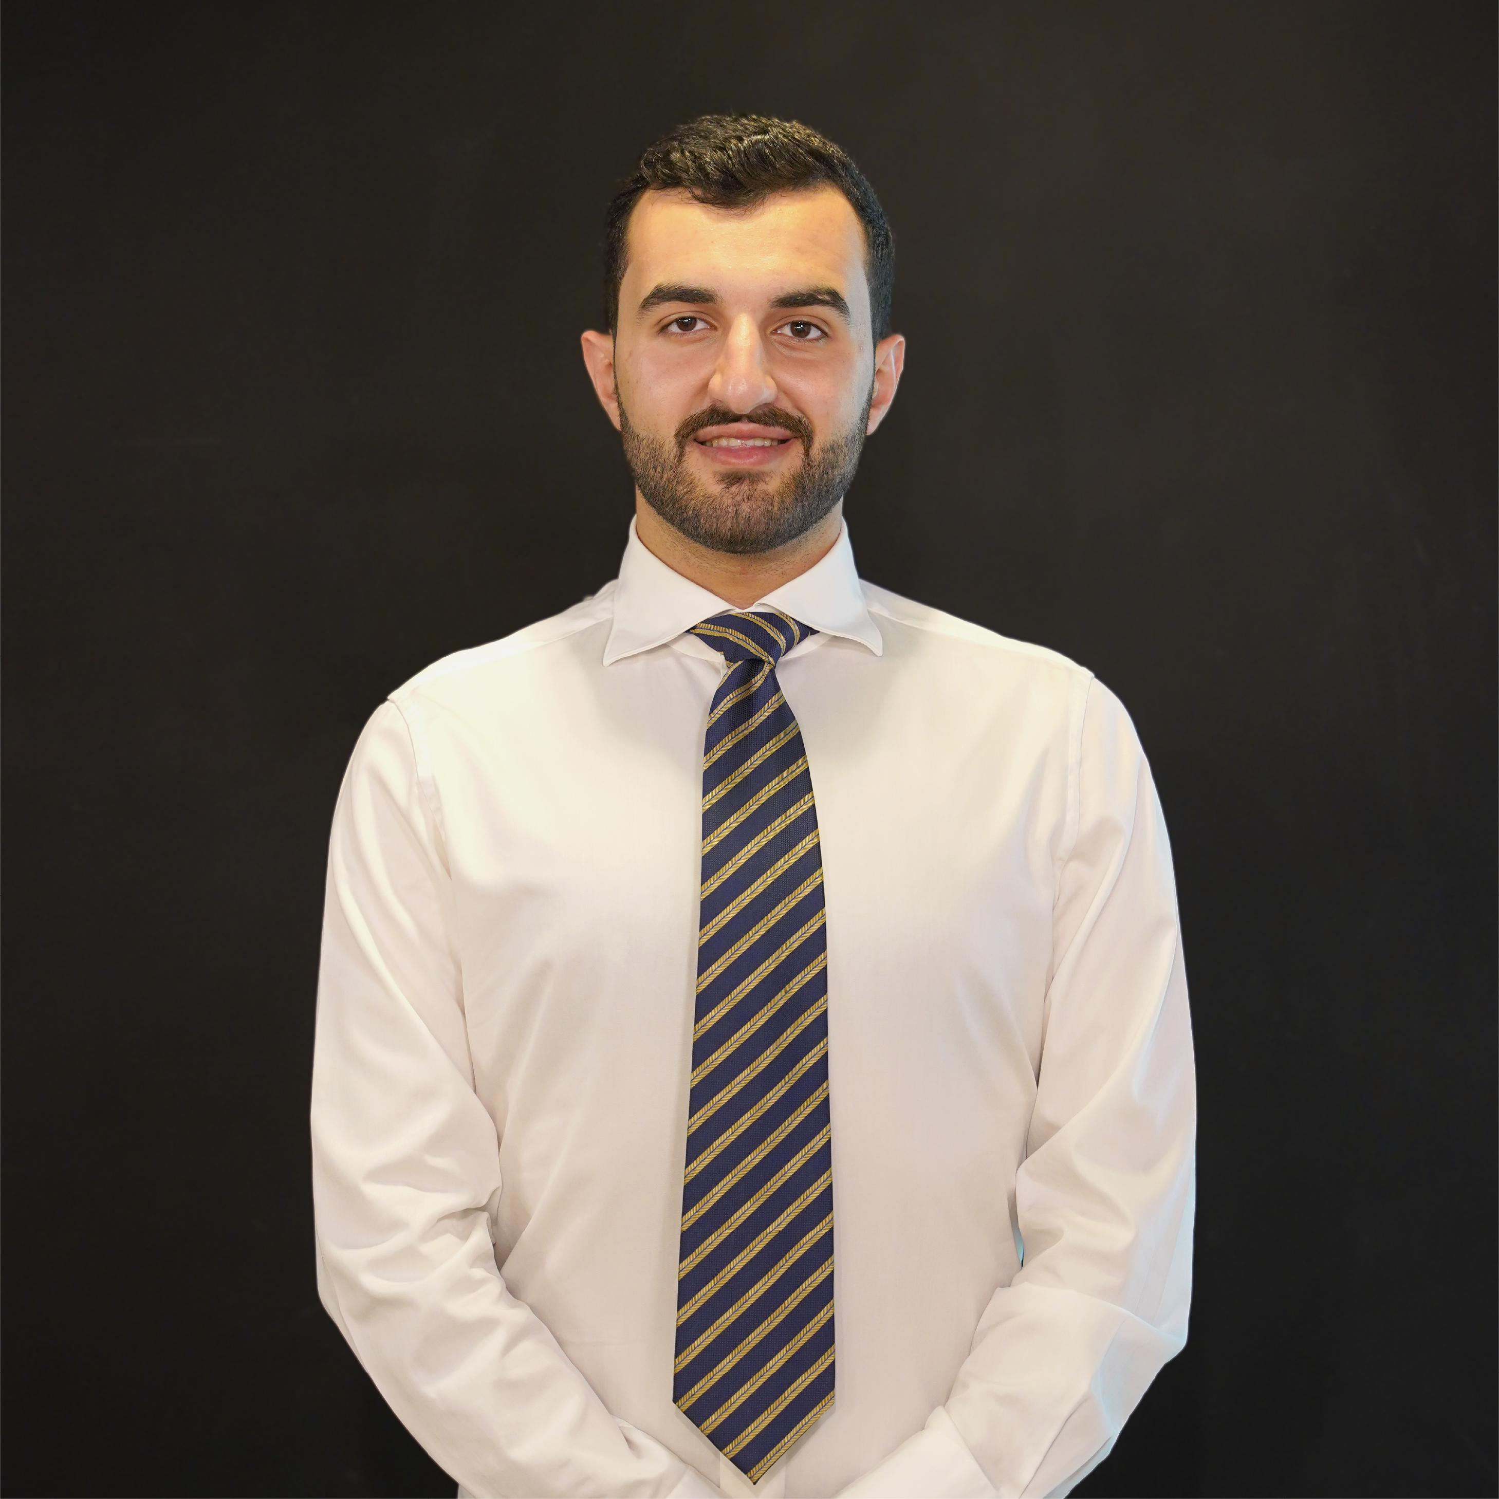
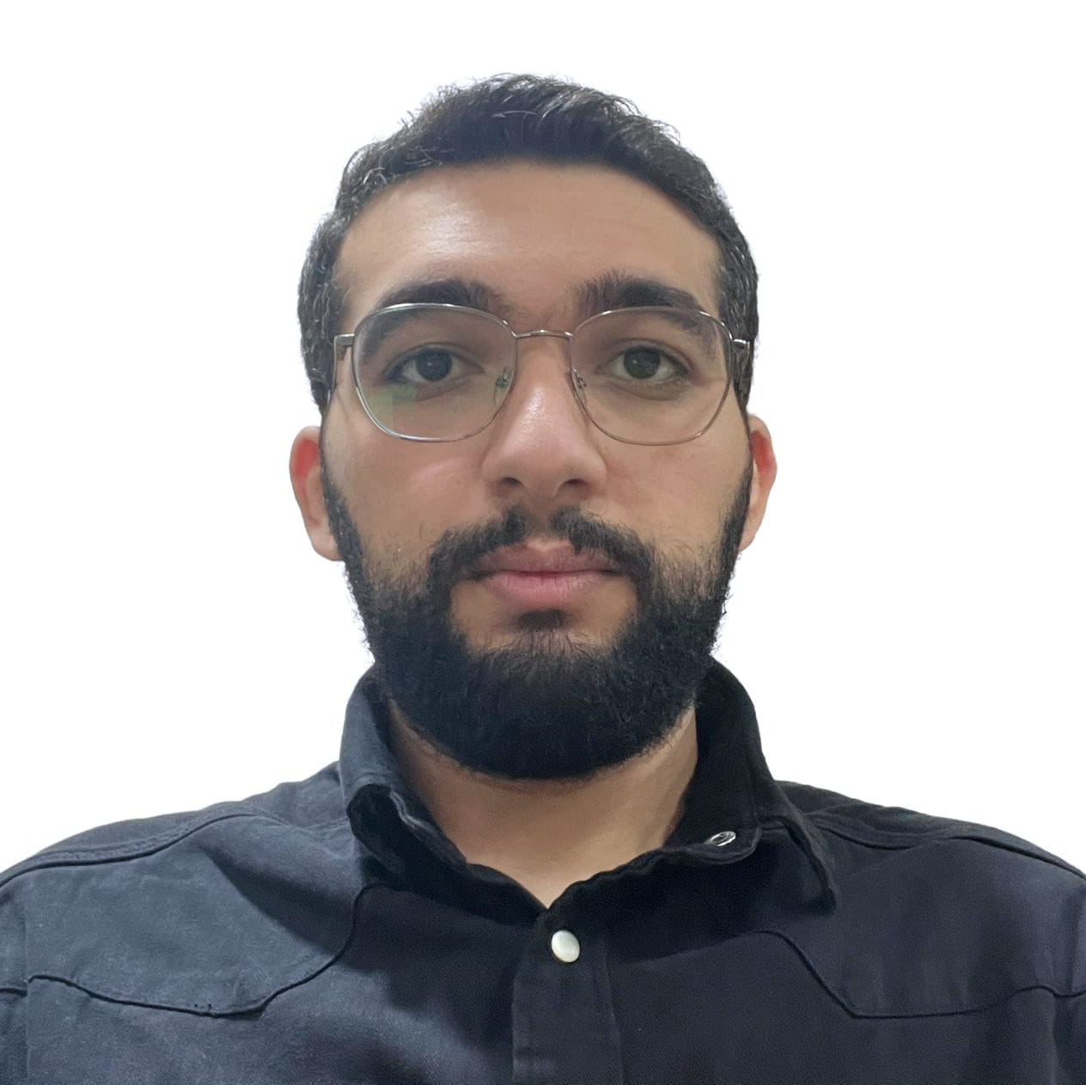
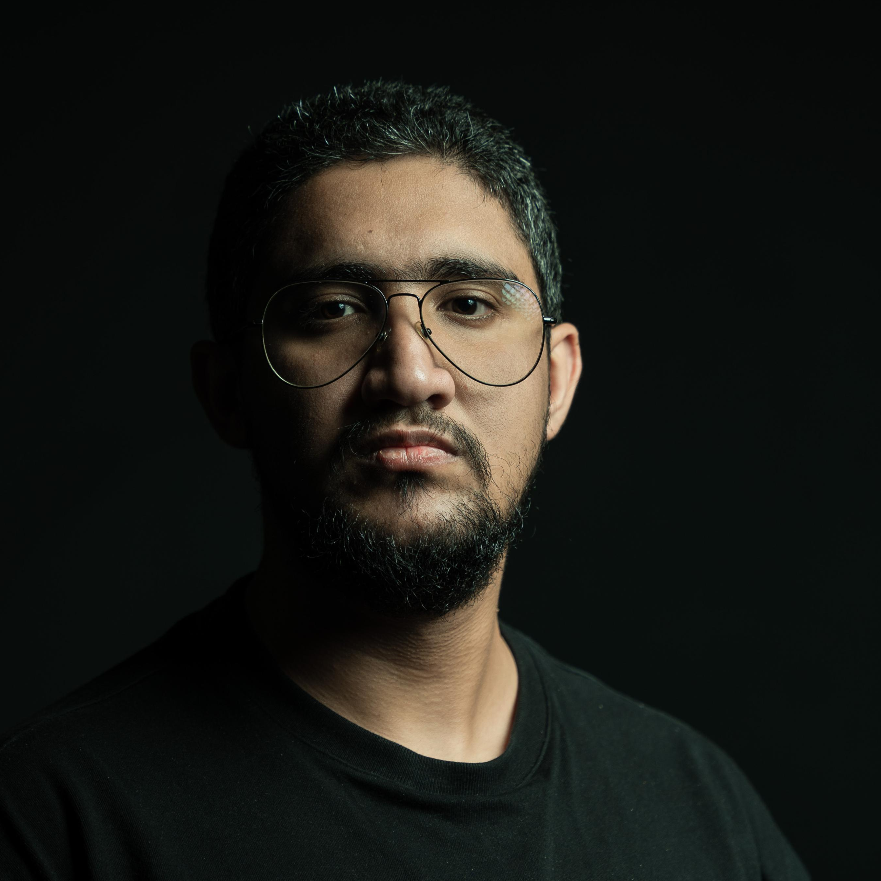
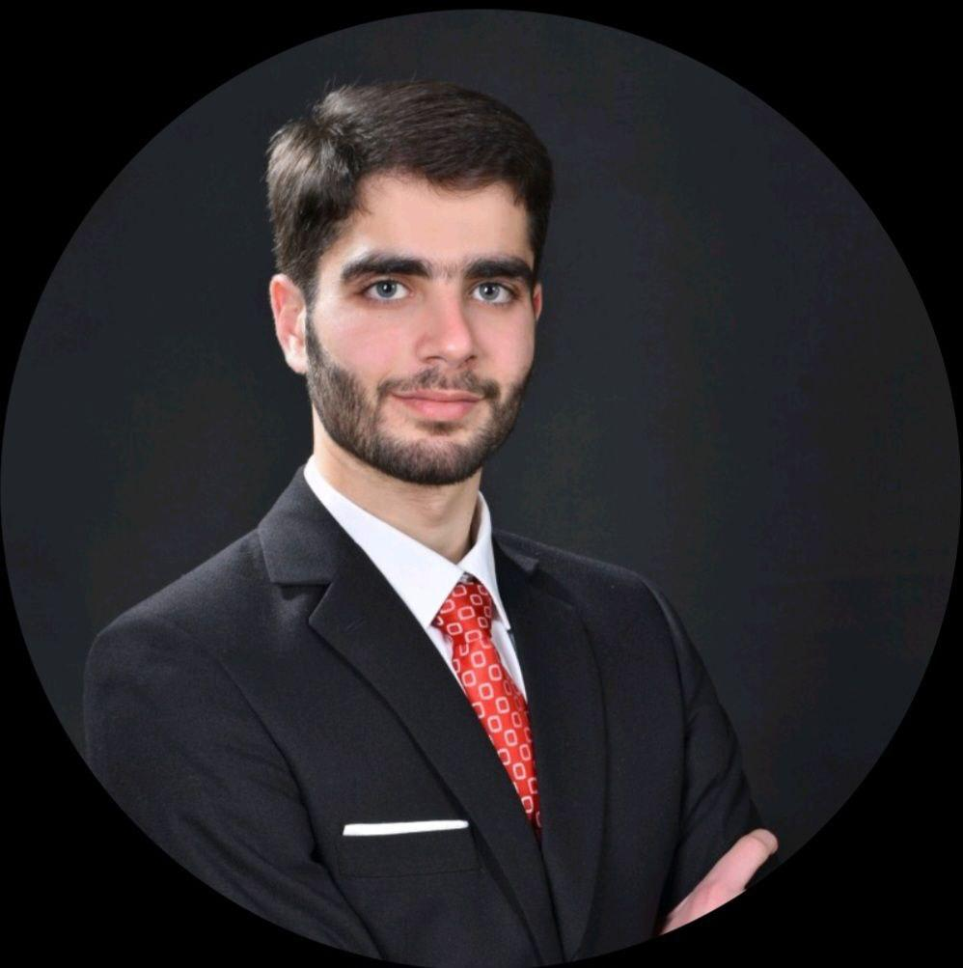
Core team!
Mohammad Tubishat
CEO
Driving vision, strategy, and business growth.
Motasim Alhmoud
CFO
Overseeing financial strategy, growth, and stability.
Abdullah Zawahreh
CCO
Lead creative designer and head of creative practice.
Adam Sabbah
CTO
Leading development, ensuring scalability and innovation.

Slide 16
Thank you

