Slide 1

TGE THARAWAT GREEN EXCHANGE
Pioneering Web3.0 for Environmental Sustainability

Slide 2
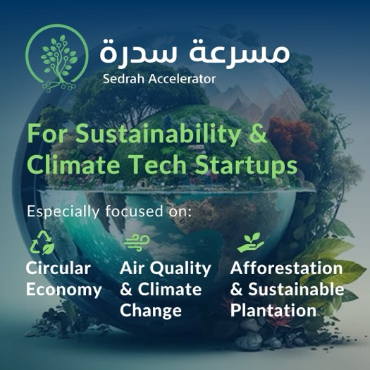
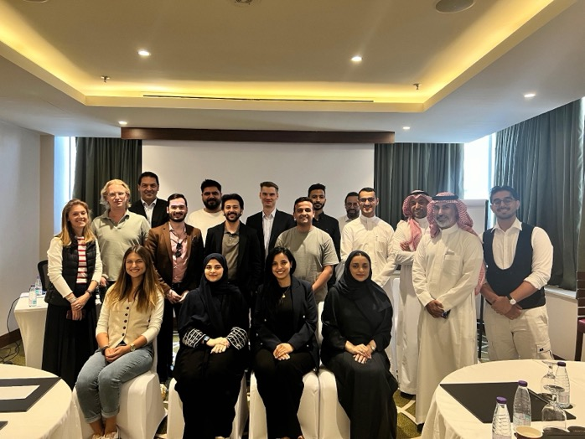
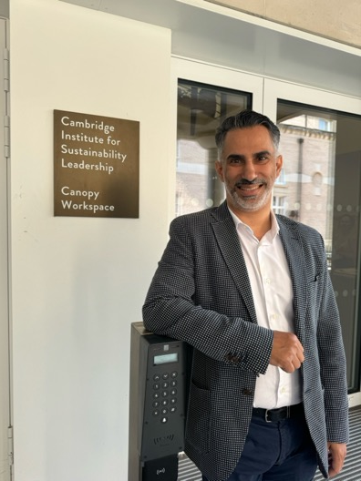

TGE has been chosen by the Sedrah Accelerator, organized by the Ministry of Environment, Water, and Agriculture, as one of 10 high-potential sustainability and climate tech startups in the region. This recognition and investment highlight our commitment to driving innovative solutions for a sustainable future.
Selected by Sedrah Accelerator

Slide 3
Tharawat Green Exchange
What is TGE?
Tharawat Green Exchange (TGE) is a blockchain-driven marketplace that facilitates carbon offsetting through tree planting. Offsetters aiming to reduce their carbon footprints use TGE to connect with projects and suppliers responsible for tree planting and maintenance, ensuring transparency via blockchain. Our goal is to plant 10 million trees by 2030, bolstering Saudi Arabia's green economy and supporting local nurseries.

Slide 4
TGE serves as a dynamic platform supporting the Saudi Green Initiative and the Net Zero Initiative. Our goal is to channel private sector investments into meaningful environmental projects, fostering a new economy centered on sustainability and direct climate benefits.
2060
Net
Zero
278m tons of CO2 per annum Market size:
600 billion USD
10b
Trees
Market size of $1.2 trillion USD government funded
2040
Market Opportunity
Saudi strategic initiatives to meet global sustainability goals

Slide 5




Our Unique Value Proposition
Why Choose Tharawat Green Exchange?
At Tharawat Green Exchange, we use Web3.0 technology to ensure transparency and security. We connect carbon offsetters with local nurseries and land projects, fostering economic growth and enhancing environmental health. Our platform makes it simple for anyone to contribute to tree planting initiatives that directly build a greener future.
Blockchain Transparency: Ensuring trust and clarity in every transaction.
Community Empowerment: Boosting local nurseries and landowners with real economic opportunities.
Environmental Impact: Direct involvement in extensive tree planting and land restoration.
Simplified Impact: Making it easy for anyone to contribute to environmental goals efficiently.

Slide 6



Purpose, Vision, and mission
Why We Created TGE?
Purpose
To empower sustainable growth by planting 10 million trees by 2030, utilizing Web3.0 to connect communities and ensure transparency in environmental contributions.
Our Vision
Building local green economies for rapid climate impact through transparent innovation.
Our Mission
"Harnessing technology to make carbon reduction transparent and effective, one tree at a time."

Slide 7
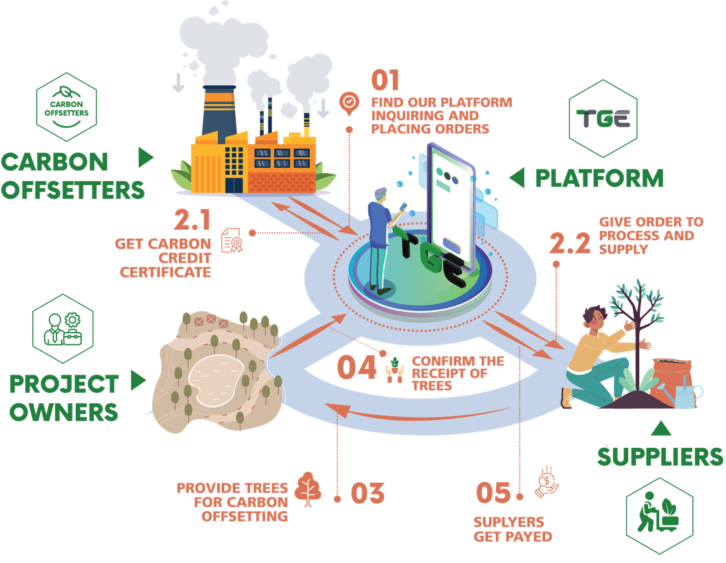
The Business Model
How do carbon credit work?

Slide 8
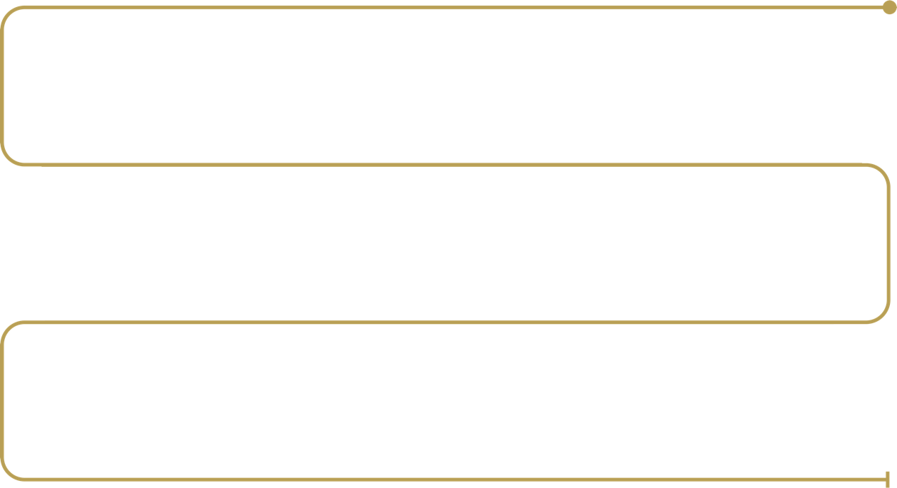

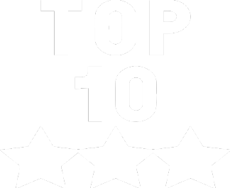
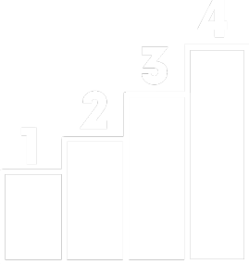
Conducted an extensive market research to determine which trees thrive in various regions of Saudi Arabia.
Shortlisted the top 10 trees based on several criteria: adaptability to regional conditions, water requirements, carbon absorption, oxygen production and harmonization with surrounding environment.
Further narrowed down to the top 4, finalizing them as the primary selections for our project
Our Detailed Tree
Selection Journey

Slide 9
+150
trees have been evaluated
Shortlisted to 10 based on survivability and ability to absorbed carbon
Shortlisted to 4 based on ability to grow in different environment in Saudi Arabia
الرقم | الاسم | الاسم العلمي | الفصيلة | الفئة
01 | المرخ | Leptadenia pyrotechnica | Asclepiadaceae | شجرة بدون ورق واسعة الانتشار
02 | السلم | Acacia ehrnbergiana | Mimosaceae | شجيرة جنوب دائرة العرض 26 درجة شمالا
03 | ام غيلان | Acacia raddian | Mimosaceae | شجرة واسعة الانتشار
04 | الحماط | Ficus palmata | Moraceae | شجيرة
05 | الأثل | Ficus salicifolia | Moraceae | شجرة
06 | الضال (السدر البري) | Ziziphus nummularia | Rhamnaceae | شجرة واسعة الانتشار
07 | الاراك | Salvadora persica | Salvadoraceae | شجيرة زيرة الفرو
08 | العوسج | Lycium shawii var shawii | Solanaceae | شجيرة واسعة الانتشار
09 | الاثل | Tamarix aphylla | Tamaricaceae | شجر زراعي
10 | السمر | Accacia tortilis | Mimosaceae | جنوب دائرة العرض 25 درجة شمالا
Selection Journey

Slide 10
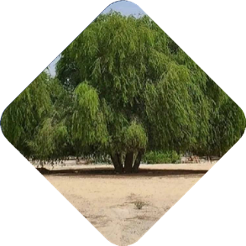
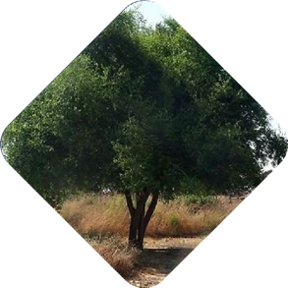
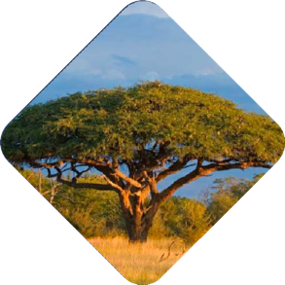
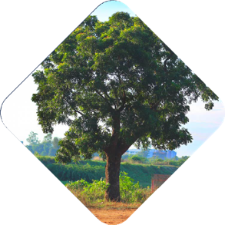
Selected Trees
PROSOPIS
شجر الغاف
ZIZIPHUS
شجر السدر
ACACIA
شجر الاكاسيا
NEEM
شجر النيم
Minimum Tree Requirements:
Trees must be at least 2 years old and over 180 cm tall, ensuring a higher probability of survival and sufficient maturity to absorb the required carbon emissions.
Native to the Arabian Peninsula, this drought- resistant tree grows in sandy soils, stabilizes sand dunes, offers shade, and has regional cultural significance.
Native to the Arabian Peninsula, is drought- tolerant, grows in sandy soil, stabilizes dunes, offers shade, and is culturally significant.
Drought-resistant and able to grow in sandy soils, this tree is ideal for Saudi Arabia, offering timber and soil enhancement.
Drought-tolerantandcapable of growing in sandy soil, it has multiple uses including as a source of timber and for medicinal purposes.

Slide 11
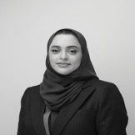
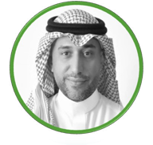
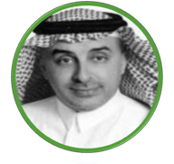
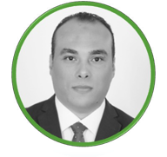
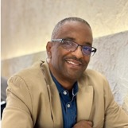
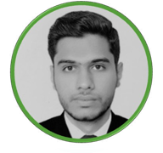
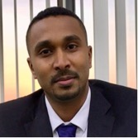

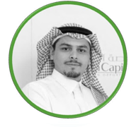
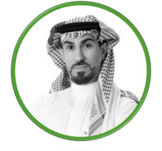
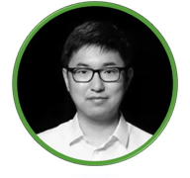
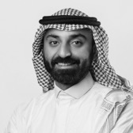
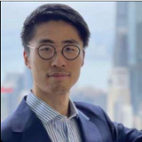
Yakeen
CEO / Cofounder
Hassan
Cofounder
Sulaiman
Business Development
Meshref
Digital
EXECUTIVE TEAM
Elwaleed
Operation
Ossama
Finance
Ossama
PMO
Ghadah
Quality
ADVISORY BOARD
Mazen
financial compliance
Yasser
Cofounder
Investor relations
Stanley
Blockchain Advisor
Ahmed
Ai and Data Advisor
Max Song
Standards Advisor
Leadership Team

Slide 12
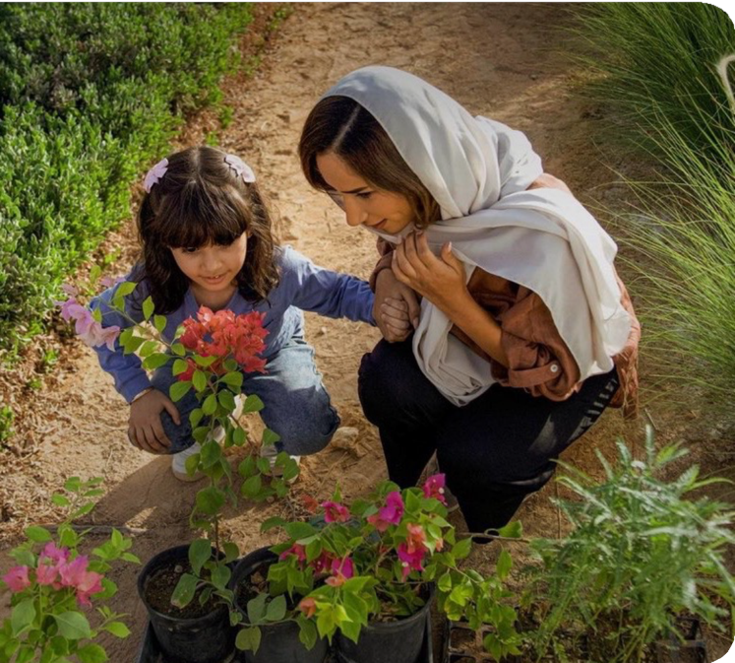
Statement of Investment
We are raising $1.5 million at a pre-seed valuation of $15 million to focus on two key areas: developing our blockchain platform and boosting our marketing efforts through social media, SEO, and Google ads. By tapping into a $500+ billion market, we aim to capture 0.1%, valued at more than $500 million, over the next 5 years in Saudi Arabia. With your support, we can expand globally, targeting a $1 trillion annual market expected to grow by 6% year over year.
Pre seed Meeter = $1,500,000
$450,000
30%

Slide 13

















Government
partners
NGO
partner
Corporate
partners
Built in compliance with carbon offsets standards
IEEE P7802
Our Partners

Slide 14

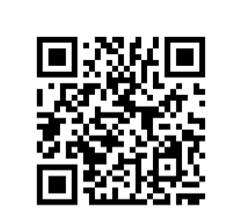
Together, let's harness the power of the Green Exchange to build a transparent greener Saudi, create a new great economy, and leave a lasting climate impact, because the future is in our hands.
THANK YOU
Yakeen Alzaki
+966 57 555 5000 | yakeen@tge.sa

