Slide 1
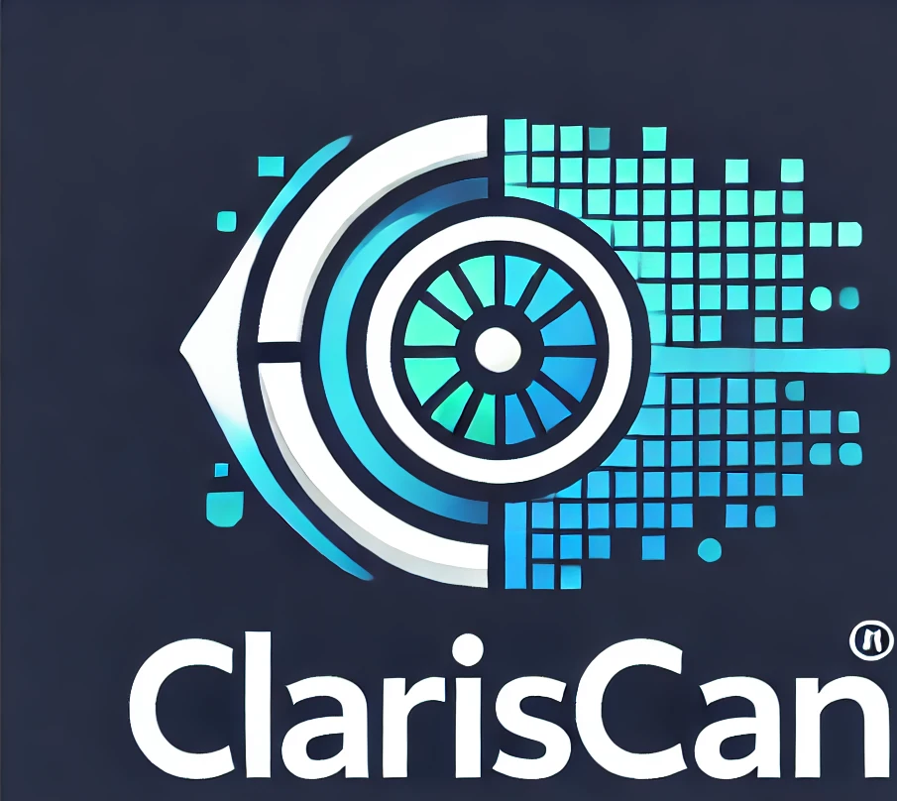
Clariscan.ai
Revolutionize Future of Healthcare with AI
By: Jameel Yousaf

Slide 2
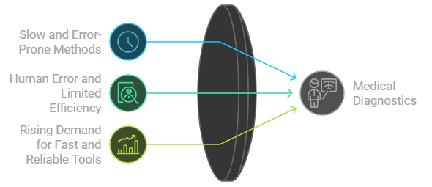
The Challenge in Medical Diagnostics
Timely and accurate diagnosis is critical but current methods are slow and prone to errors.
Healthcare providers struggle with human error and limited efficiency in image-based diagnoses.
Increasing demand for fast and reliable diagnostic tools as chronic diseases rise globally.

Slide 3
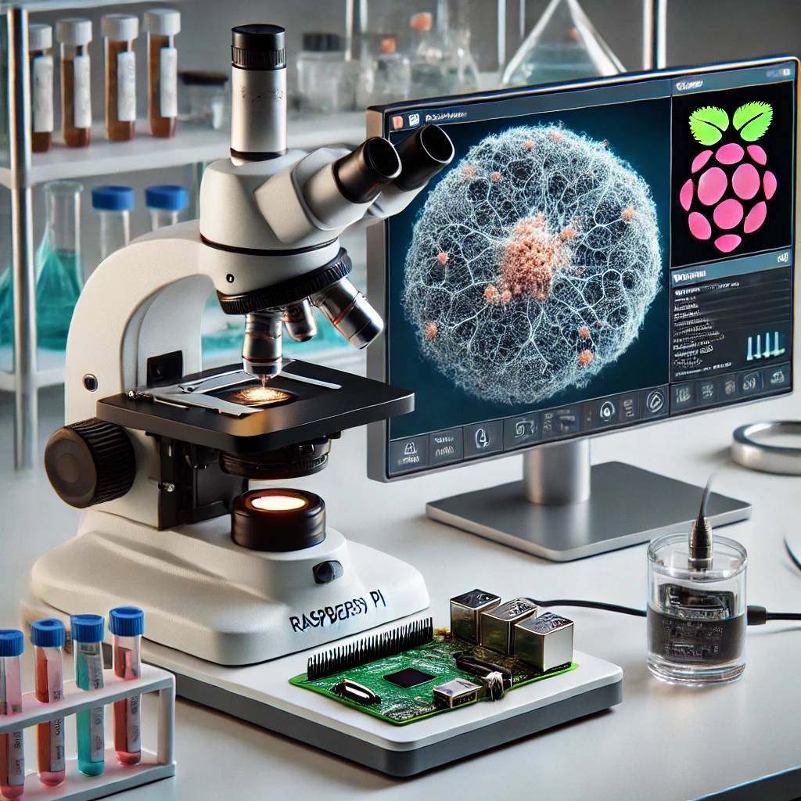
Clariscan.ai: The Solution
Phase 1: AI-powered medical image diagnostic software. Detect diseases early and improve diagnostic accuracy using machine learning and deep learning techniques.
Phase 2: Hardware integration—embedding the system into medical devices (e.g., microscopes) with Raspberry Pi 5 for real-time, seamless medical diagnosis.
Two-stage approach to ensure scalable solutions for software and hardware.

Slide 4
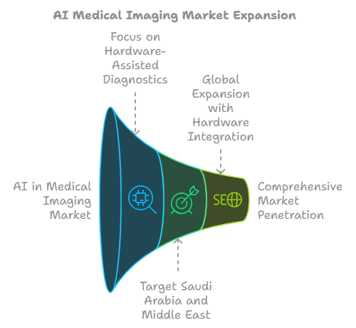
Market Potential
Growing global AI in medical imaging market projected at 35.8% CAGR.
Hardware-assisted diagnostics is an untapped segment with significant growth potential, especially for smaller clinics.
Targeting Saudi Arabia and the Middle East with phase 1 (software), expanding globally during phase 2 (hardware integration).

Slide 5
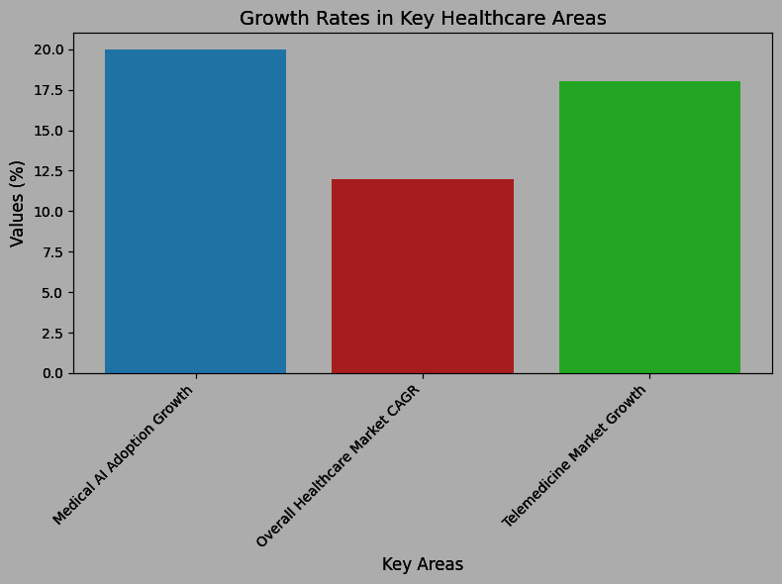
Market Potential
Global Market Potential: Grow at a CAGR of 35.8%
KSA Potential: Medical AI adoption grow 20% annually

Slide 6
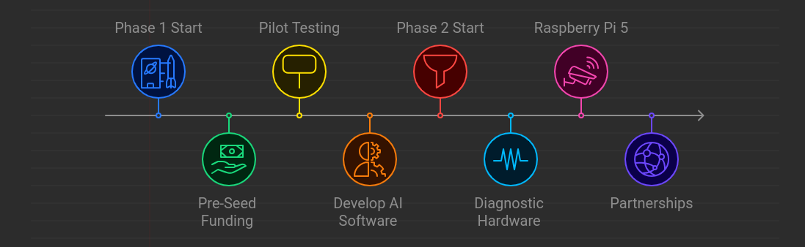
Phased Approach
Two-Phase Development Plan
Phase 1 (Years 1-2):
Develop AI-powered diagnostic software for medical image analysis.
Focus on pilot testing and building relationships with hospitals and clinics.
Target pre-seed funding.
Phase 2 (Years 3-5):
Embed the software system into medical diagnostic hardware (e.g., microscopes).
Use Raspberry Pi 5 for real-time, hardware-integrated AI processing.
Develop partnerships with medical device manufacturers.

Slide 7
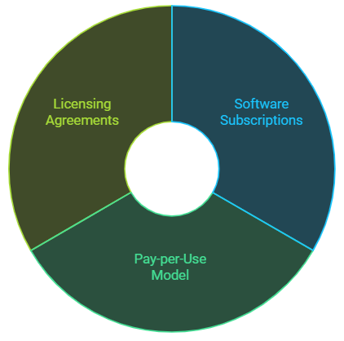
Revenue Generation Strategy
Phase 1: Software subscriptions and pay-per-use model.
Phase 2: Licensing agreements with medical device manufacturers, or direct hardware-software bundled products for clinics.
Flexibility to offer different pricing structures based on scale (small clinics vs large hospitals).

Slide 8
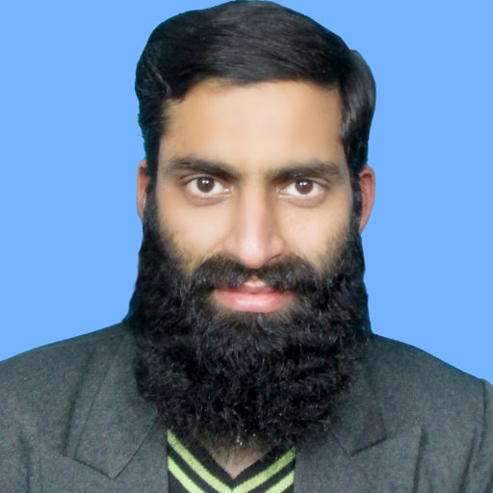
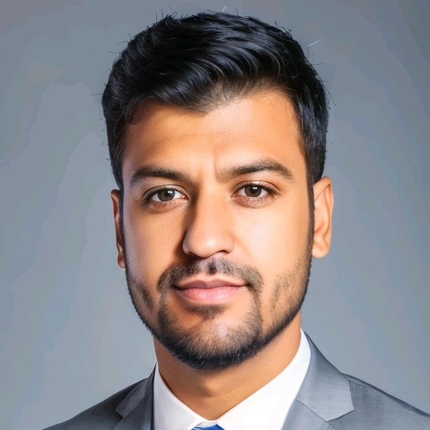
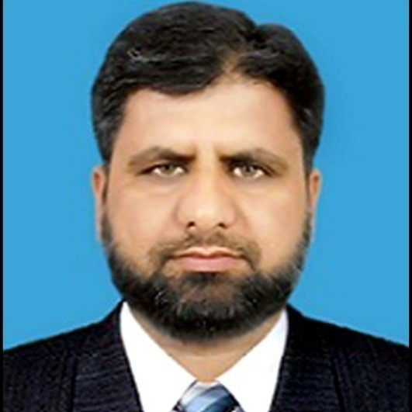
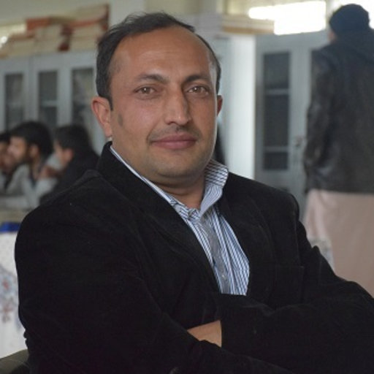

Team & Expertise
Co-founder & CEO
Co-founder & CEO: Dr. Zakir Khan – AI & medical imaging expert.
Co-founder: Jameel Yousaf – Tech innovator & Business Development manager.
AI Expert: Dr. Muhammad Shahzad – Specializes in deep learning for medical image processing.
Data Scientist: Dr. Syed Hamad Shriazi – Oversees data quality and analytics.
Outsourced Roles: Medical specialists, legal advisors, and QA engineers during both phases.
Co-founder & Tech Innovator
AI Expert
Data Scientist
Outsourced Roles

Slide 9
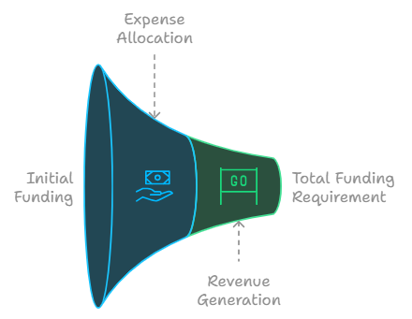
Financial Outlook for Phase 1
(Software Development)
Year 1-2 Projections:
Expenses: $1,400,000 for product development, team expansion, regulatory compliance, and market launch.
Revenue: $500,000 from initial pilot testing and subscriptions.
Total Funding Required for Phase 1: $4.525 million.

Slide 10
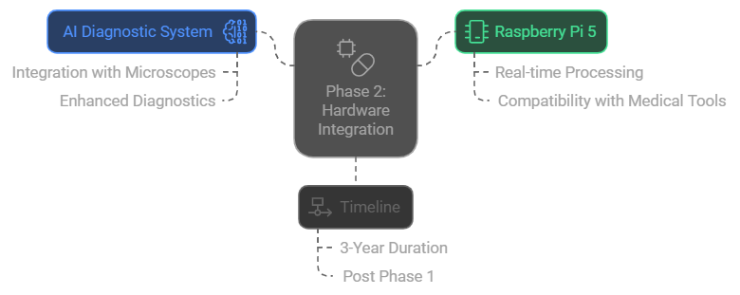
Phase 2: Hardware Integration with Medical Devices
Embedding the AI diagnostic system directly into medical devices like microscopes.
Utilizing Raspberry Pi 5 for real-time diagnostics alongside medical tools.
Phase 2 will take 3 additional years after Phase 1 is complete.
Image Suggestion: A Raspberry Pi-based system embedded in a medical device like a microscope.

Slide 11
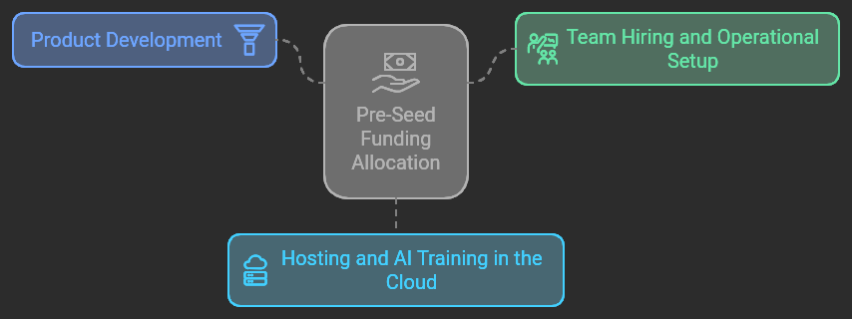
Pre-Seed Funding Request
Total Funding Required:
$500000 for Pre-Seed
Tentative Allocation:
  Product development
  Team hiring and operational setup
  Hosting and AI training in the cloud

Slide 12
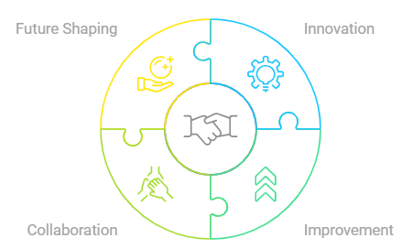

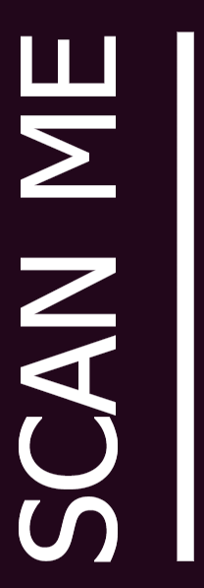
Join Us to Transform Healthcare Future
Clariscan.ai is positioned to transform both software and hardware in the healthcare diagnostics field.
We invite you to partner with us to realize this vision, beginning of AI software development.

