Slide 1


Pitch
Deck

Slide 2

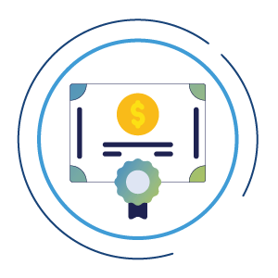
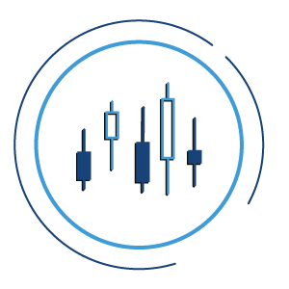
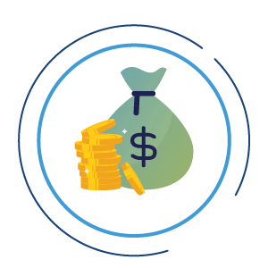
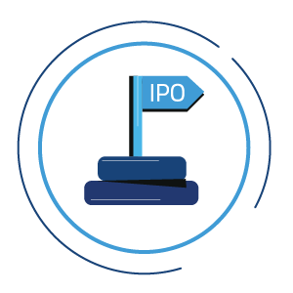
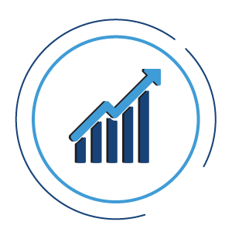

Qannas Your One-Stop Investment Hub For Managing, Learning, Investing.
Sukuk
Stocks
Funds
IPO
Investments
Real Estate

Slide 3


PROBLEM
Fragmented Portfolio Management
  Investors In The Saudi Market Struggle To Manage Multiple Portfolios Across Various Brokers Efficiently. Qannas Streamlines This Process, Providing A Unified Platform For Comprehensive Portfolio Management, Analysis, And Reporting.
Limited Access To Brokerage Platforms
  Accessing Brokerage Platforms In Both KSA And USA Markets Can Be Cumbersome And Time-consuming. Qannas Integrates With Stock Market Brokers, Offering Users Seamless Trading Capabilities Across Borders, Enhancing Accessibility And Convenience.
Lack Of Investment Community Engagement
  Many Investors Lack A Platform To Share Experiences And Recommendations, Hindering Their Ability To Make Informed Decisions. Qannas Fosters A Vibrant Investment Community Where Users Can Interact, Share Insights, And Collaborate, Empowering Them To Make Smarter Investment Choices.
51%
39%
Of Participants In The National Financial Technology Survey In Saudi Arabia Are Looking For Solutions That Help Them Invest More Easily.
Of Individuals Participating In The National Fintech Survey In Saudi Arabia Searched For Solutions That Could Help Them Manage Budget/Savings.

Slide 4
Strategic Refinement
Regulatory Constrains
Competitive Edge
Regulatory barriers in directly linking portfolios with financial institutions. This requires us to find alternative strategies to maintain our competitive edge.
To differentiate ourselves in the market, we must find and leverage unique strengths that set Qannas apart from competitors.
Initiative | Strategy | Benefit
Qannas Community Focus | Build and nurture a vibrant investment community with educational resources and expert insights. | Drives user engagement, builds a strong user base, and increases brand loyalty.
Secondary Market Emphasis | Offer a platform for trading shares and secondaries. | Generates immediate revenue and reduces dependency on external integrations.
Enhanced Portfolio Management | Improve portfolio management features to provide better analytics and user experience. | Keeps users engaged and provides immediate value while integration is pending.
Opportunities Marketplace | Continue to engage customers by adding a marketplace of opportunities like stocks, IPOs, sukuk, etc. | Provides diverse investment options, enhancing user engagement and creating additional revenue streams.

Slide 5
Targets For The Next 6 Months
Portfolio Management
Opportunities Added:
  Add 500 new portfolios with a 10% increase monthly.
Retention:
  Maintain an 85% portfolio retention rate.
Satisfaction:
  Achieve an 80% customer satisfaction score in portfolio management.
Qannas Community
User Engagement:
  Achieve a 15% growth in Monthly Active Users (MAU).
  Increase post interactions (likes, comments, shares) by 20% per month.
Content and Community Growth:
  Generate 300 user-generated posts and 40 expert articles/videos.
  Secure 1500 new member sign-ups and maintain an 85% retention rate.
Event Participation and Revenue Generation:
  Host 6 webinars with a target of 300 participants total.
  Generate SAR 15,000 in revenue from premium memberships and events.
Partnerships and Influencer Engagement:
  Onboard at least 20 influencers and industry experts.
  Establish 3 strategic partnerships to enhance platform offerings and reach.
Opportunities
Opportunities Added:
  Add 4,862 investment opportunities over 6 months.
Revenue Target:
  Generate SAR 120,000 in revenue from commissions on secondary market trades.
Broker Partnerships:
  Secure partnerships with 5 brokers.

Slide 6
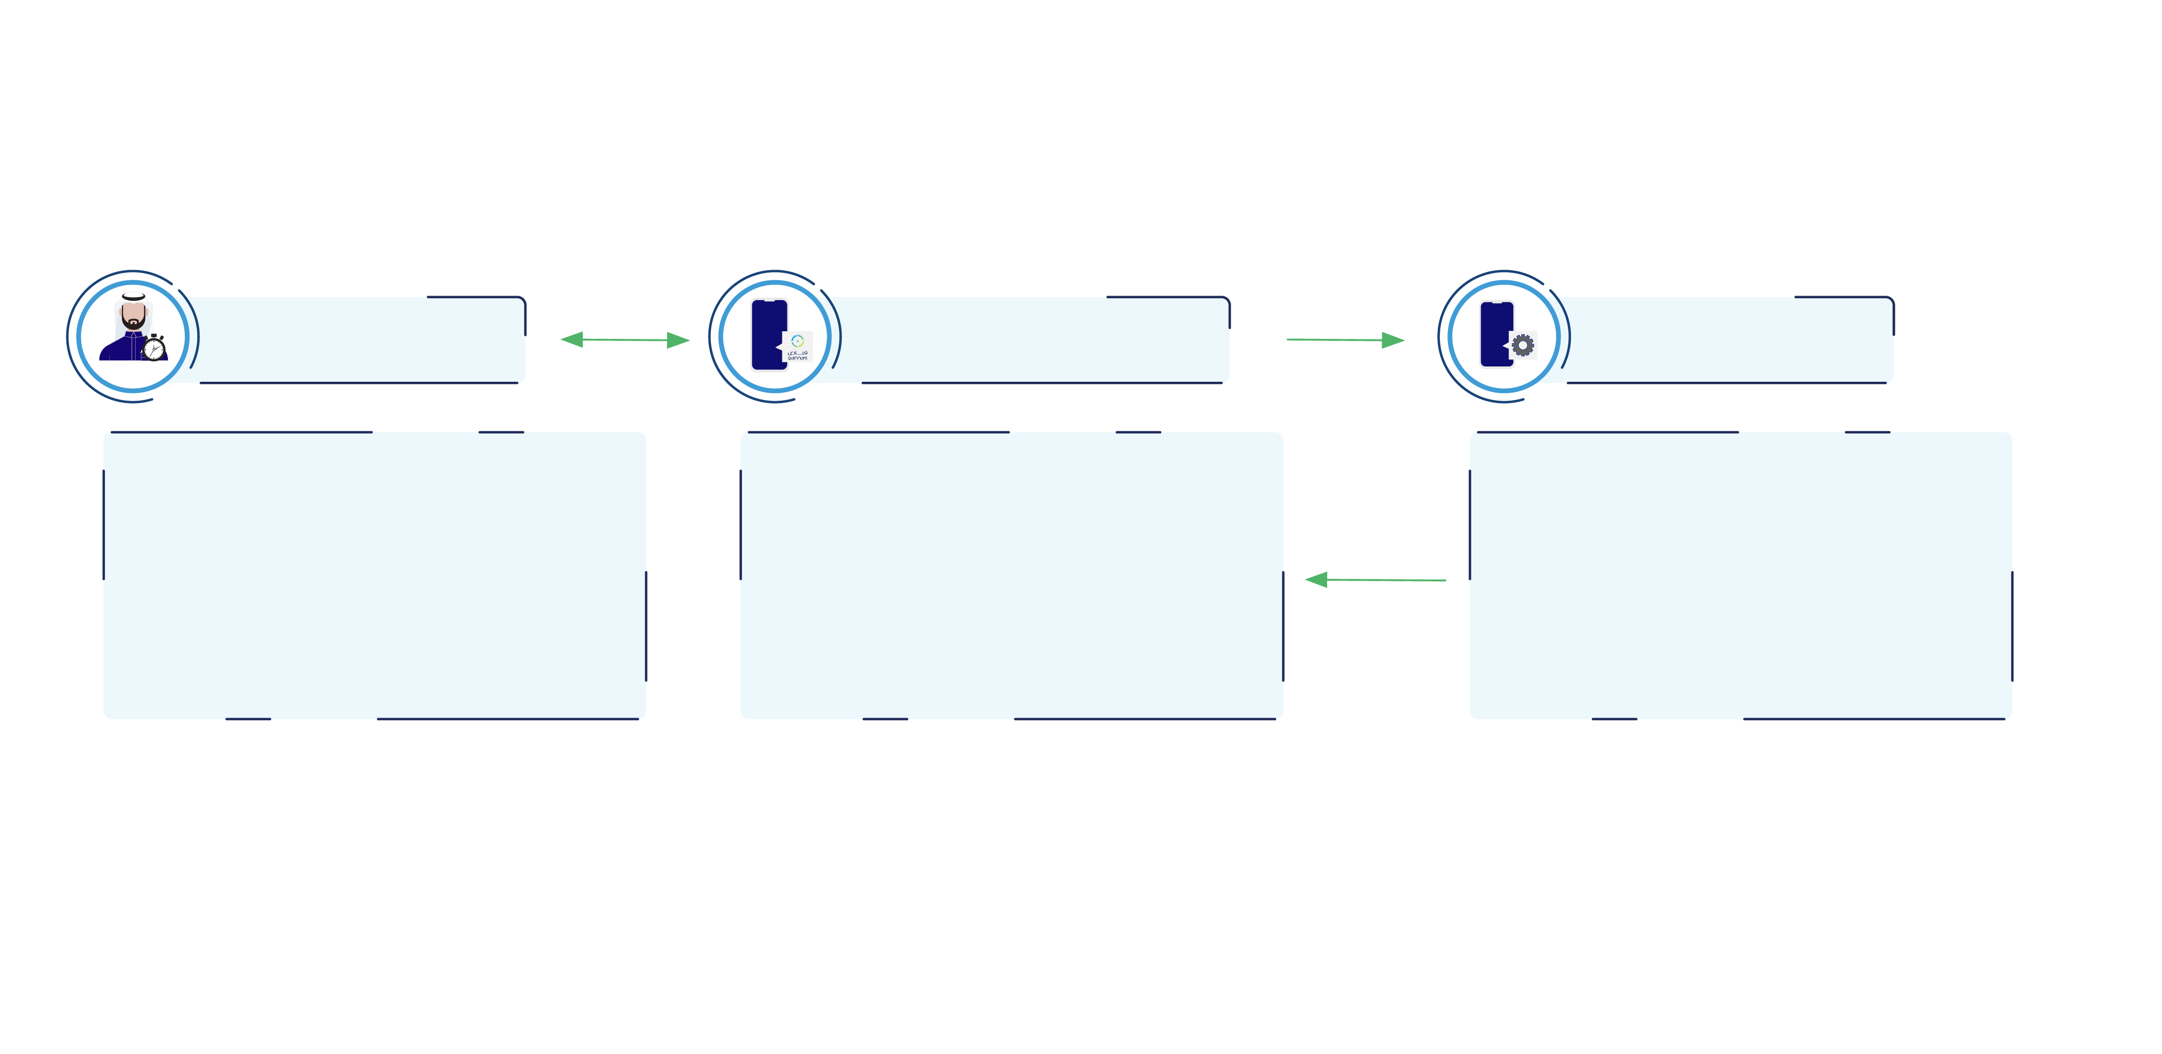
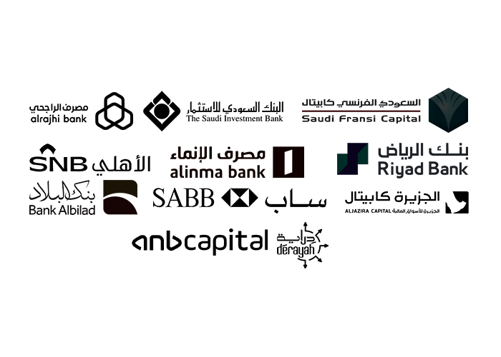
Solution
"Qannas: “Broker of brokers
“Your One-Stop Investment Hub for Managing, Learning, and Investing in Stocks, Funds, and More! Empowering you to make better investment decisions with streamlined asset management and personalized portfolio analysis for tailored insights."
Real Time
Connections
Investors
Qannas Platform
Brokers
Single Dashboard
Single KYC
Personalized portfolio analysis
Open Multi Portfolios
Link your Portfolios
Request an Transactions
Getting Data
Send Data

Slide 7

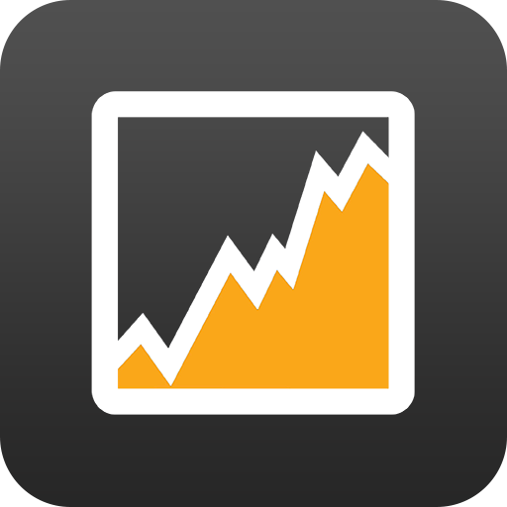






THE COMPETITORS
Investments Assets Management
⁠Investment Community
Marketplace Of Opportunities
Sell & Buy Orders
Personalized Portfolios Analytics
In Progress
⁠Wealth Management
Easy To Use
Support Saudi & USA Markets
Personalized Investor Journey

Slide 8
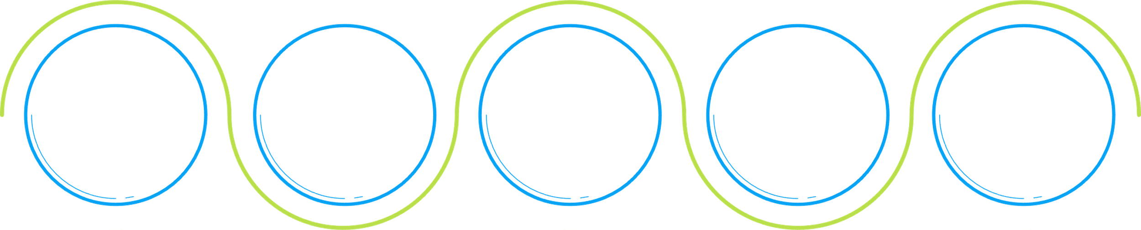
OUR PRODUCT
General:
Total of App Downloads
Total of
subscribers
Financial
Calendar
5,478
139
113
3
223
Total of brokers
Supported Markets

Slide 9
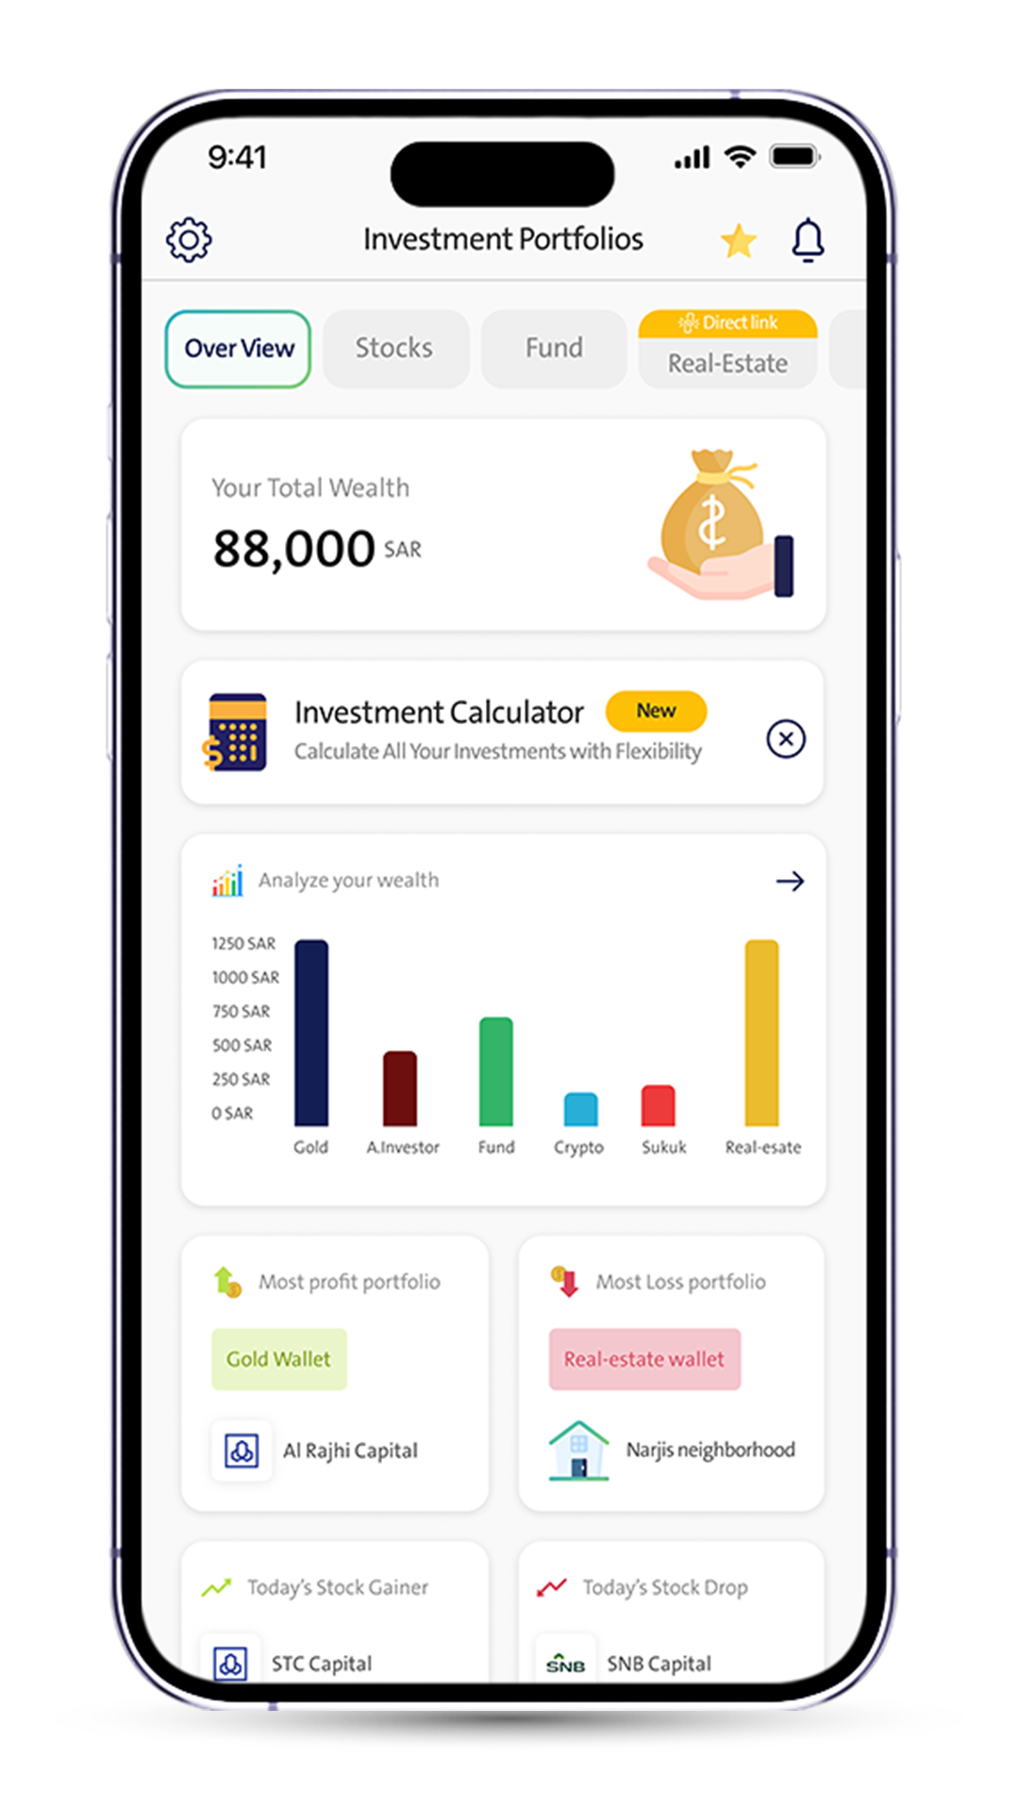

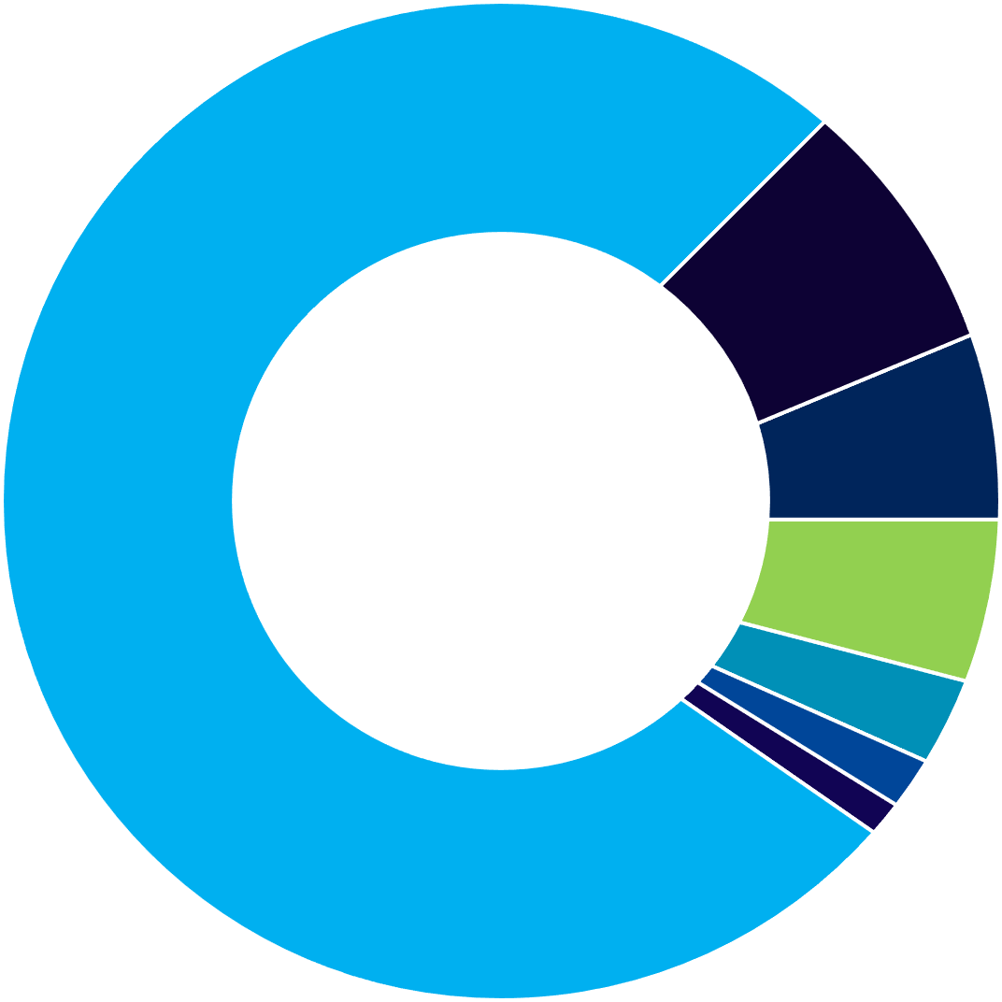
Portfolios Management
Investment Portfolio:
Stocks: 1799
Fund: 224
Crypto: 71
Gold: 57
Sukuk: 13
Real estate: 8
Angel Investors: 1
Total : 2173
224
71
2173
57
13
1799
8
1

Slide 10
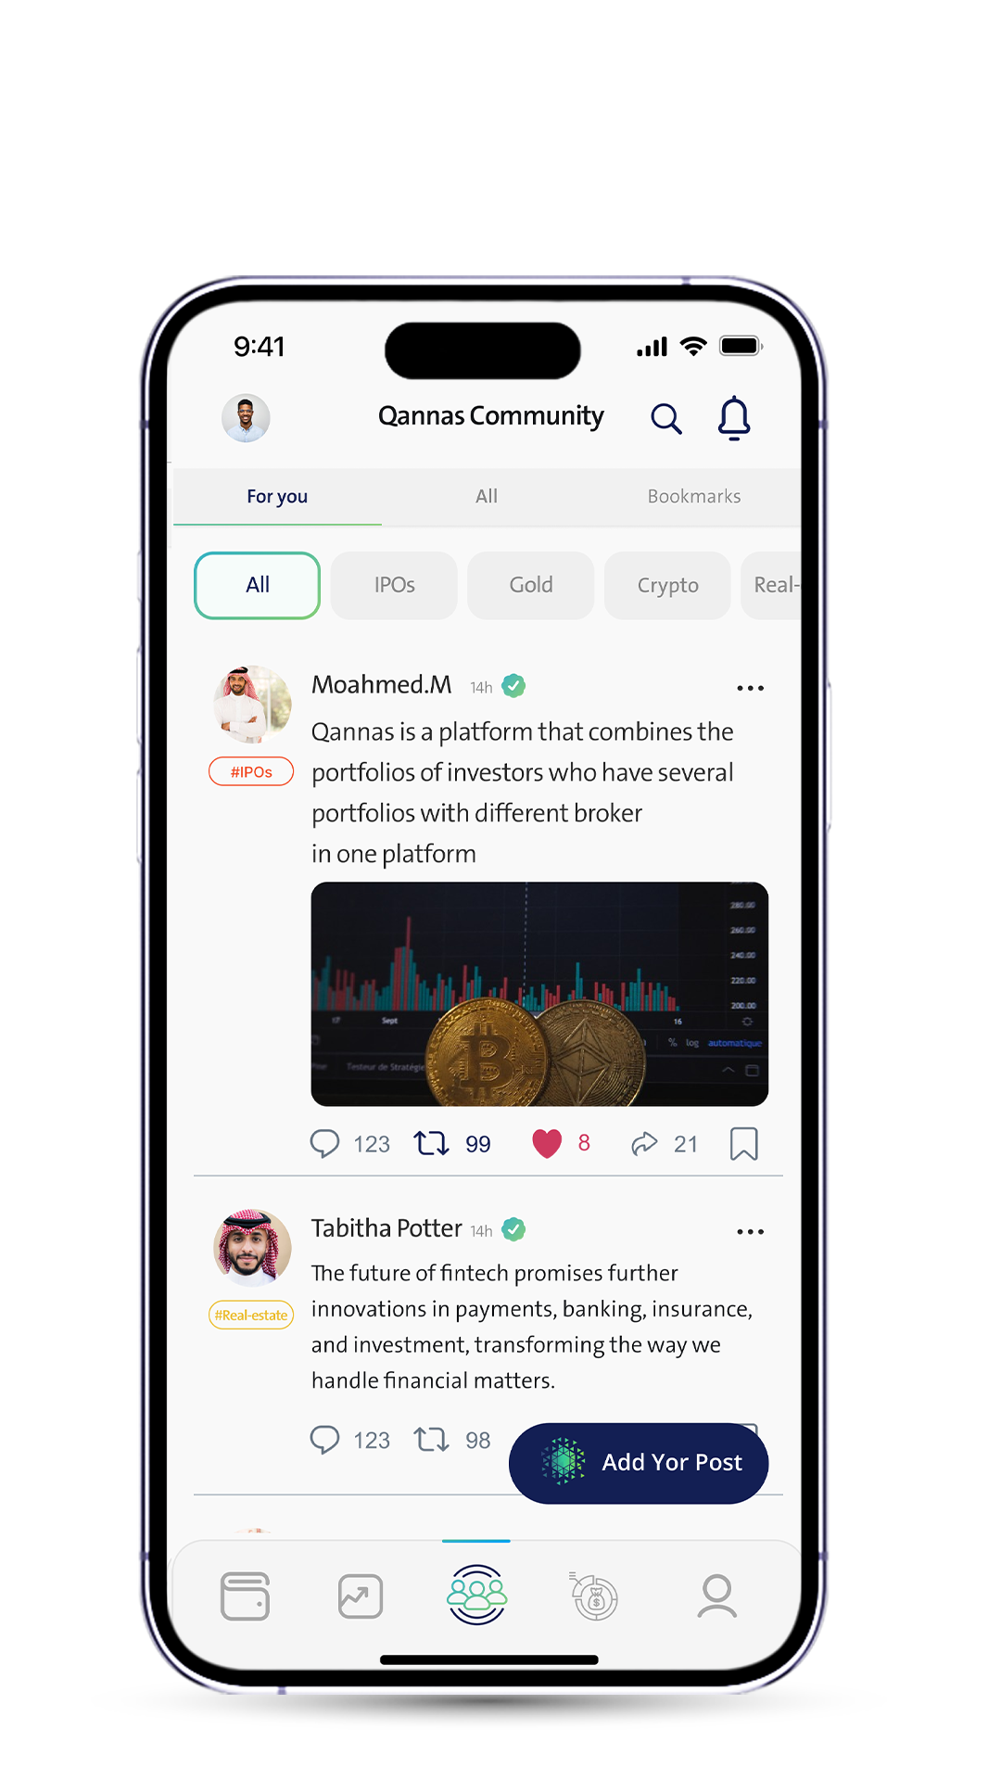




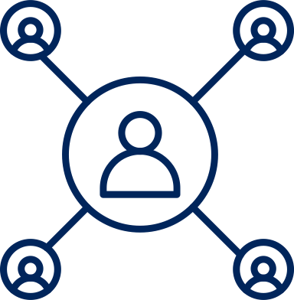
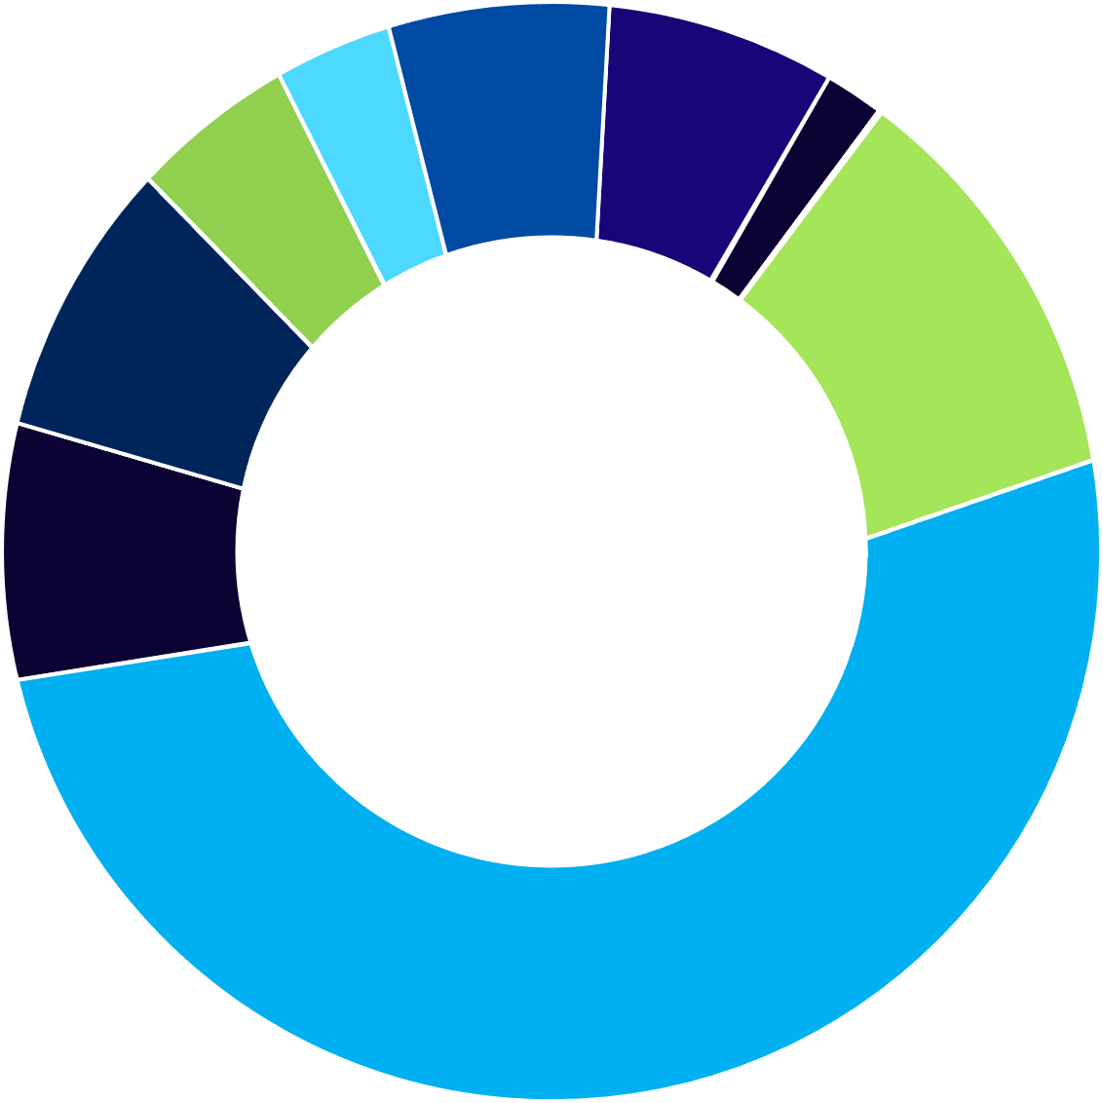
Community Product
Community Product:
Since 22 May 24 - 31 Aug 24
Total Comment : 480
Total Registed Users : 700
Total Engaging Users : 173
115
34
Posts Distribution:
45
99
87
Stocks : 1861
IPOs : 189
Market funds : 186
Real estate : 87
Gold : 45
Ventur capital : 115
Crypto : 99
Sukuk : 34
Other : 952
Total : 3568
186
952
3568
189
1861

Slide 11
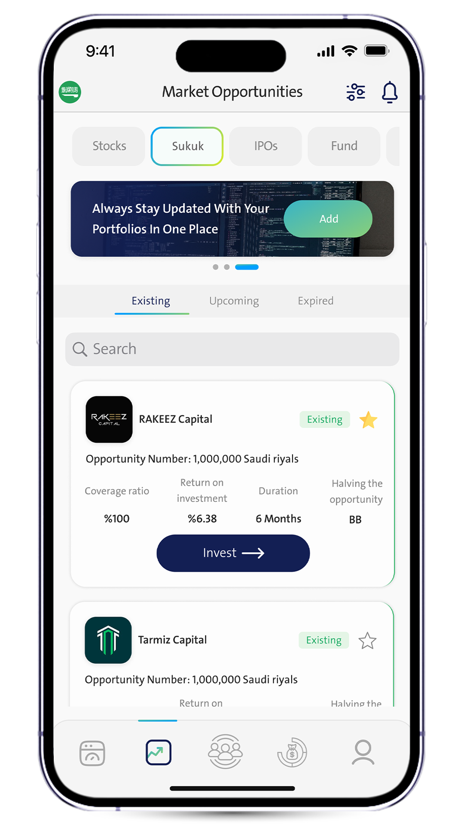


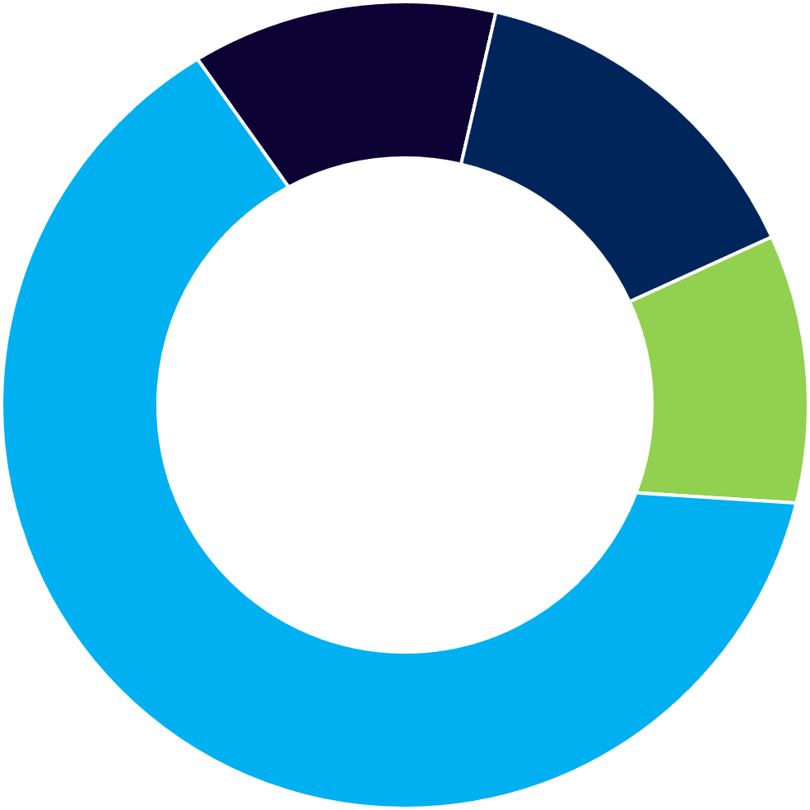
Marketplace
Marketplace: ( Manual )
Since 21 July 24 - 31 Aug 24
Avg.Opportunities Daily: 13
Total Brokers: 11
Opportunities Distribution:
49
52
Sukuk 355
⁠Funds 44
⁠IPO 52
⁠Secondary Market 49
Total opportunities in qannas
market place : 500
44
500
355

Slide 12


REVENUE STREAMS
5%
Premium Subscriptions
SAR 270 Annually.
SAR 160 Half Annually.
SAR 30 Monthly.
Commission Of Trading Brokerage Firms On Transaction Commission.

Slide 13




OUR ASK
$500K
28%
Payroll
Seed Round
Financing The Next 18 Months
12%
Other
To Reach:
790.4k Active Users.
101.9K Active Premium Users.
$17.43M Annual Revenue In Year 5.
30%
30%
Product Development
Marketing, Sales & Partnerships

Slide 14
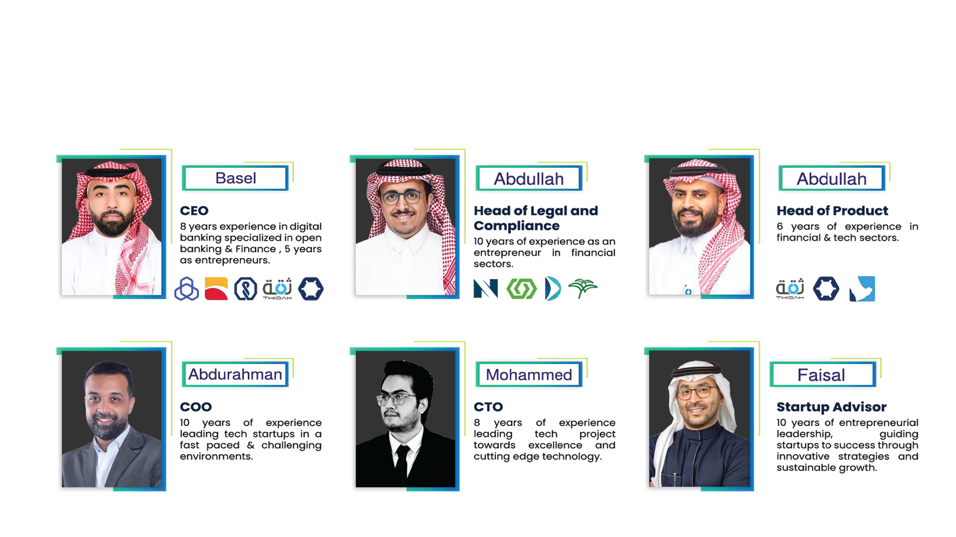
EXECUTIVE TEAM

Slide 15
THANK YOU!
www.qannas.co
+966 50 536 6862
invest@qannas.co

